Slide 1
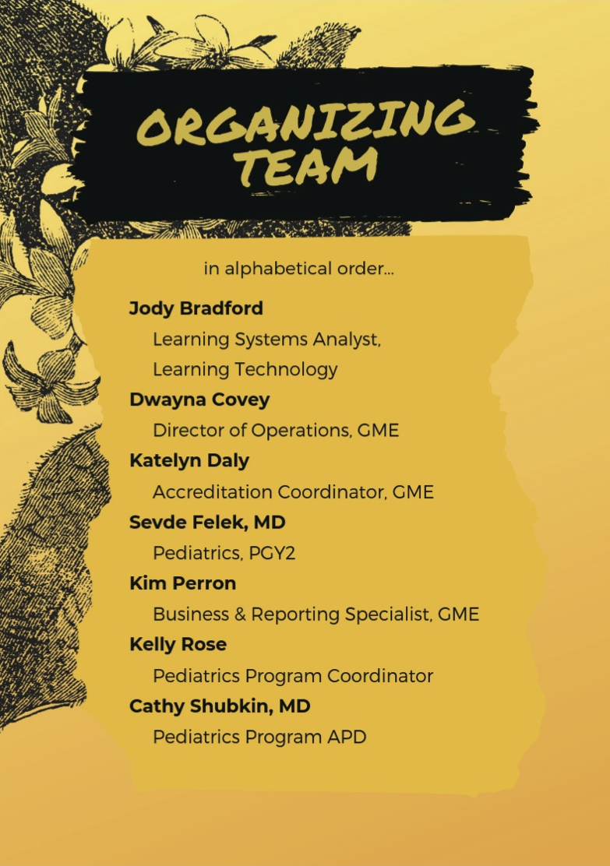
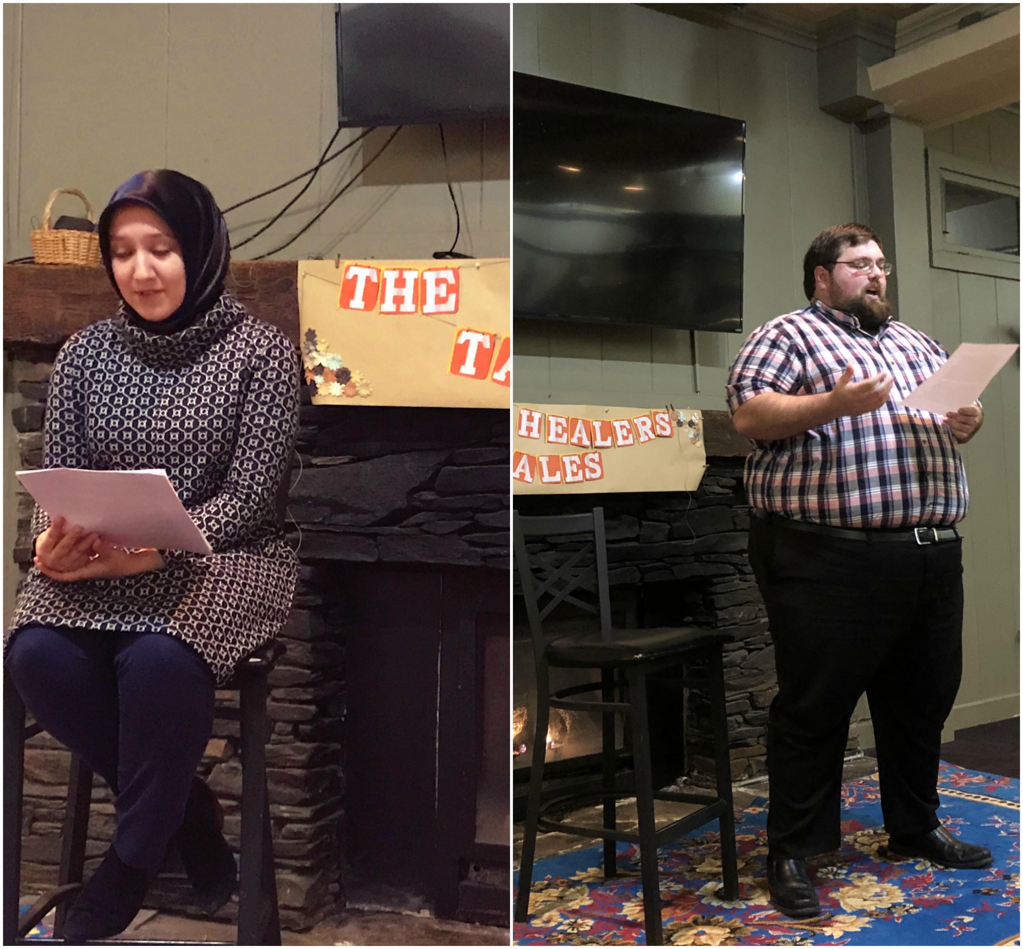
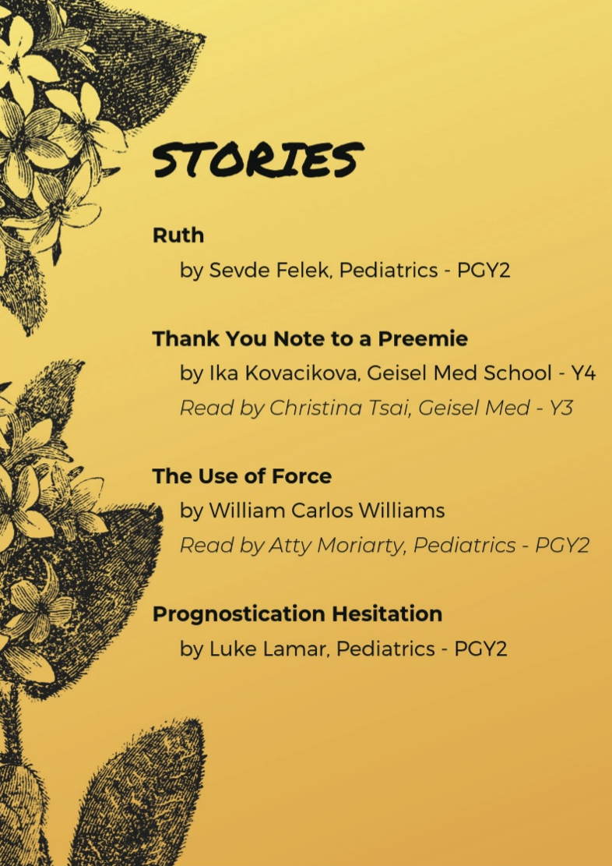
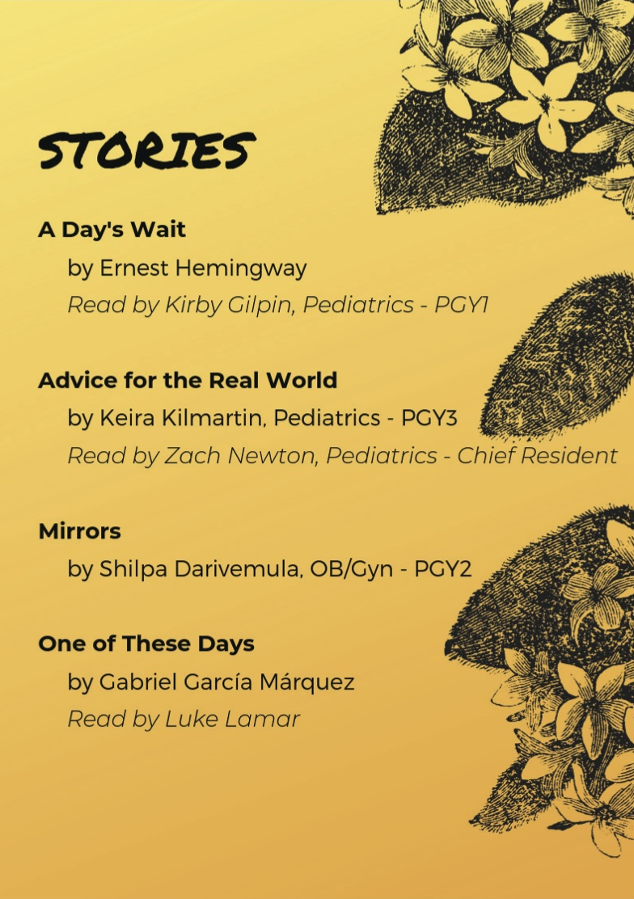
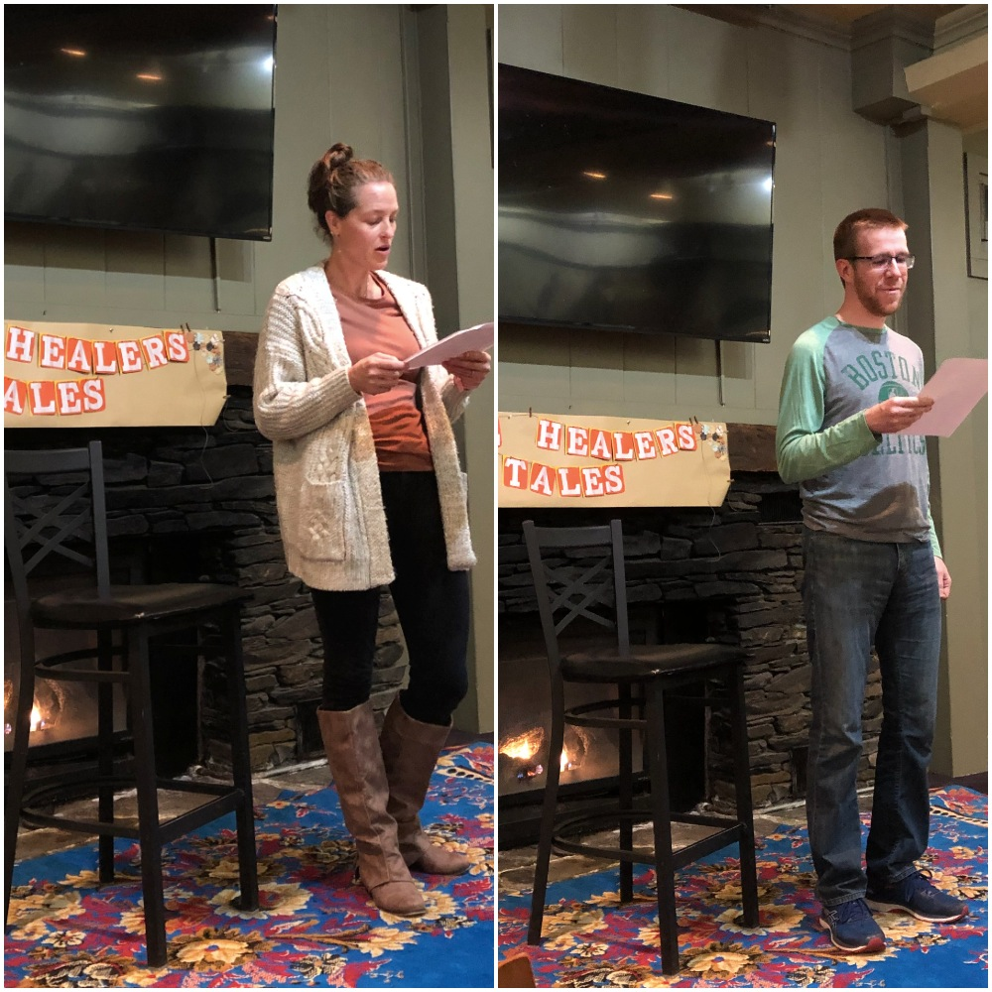
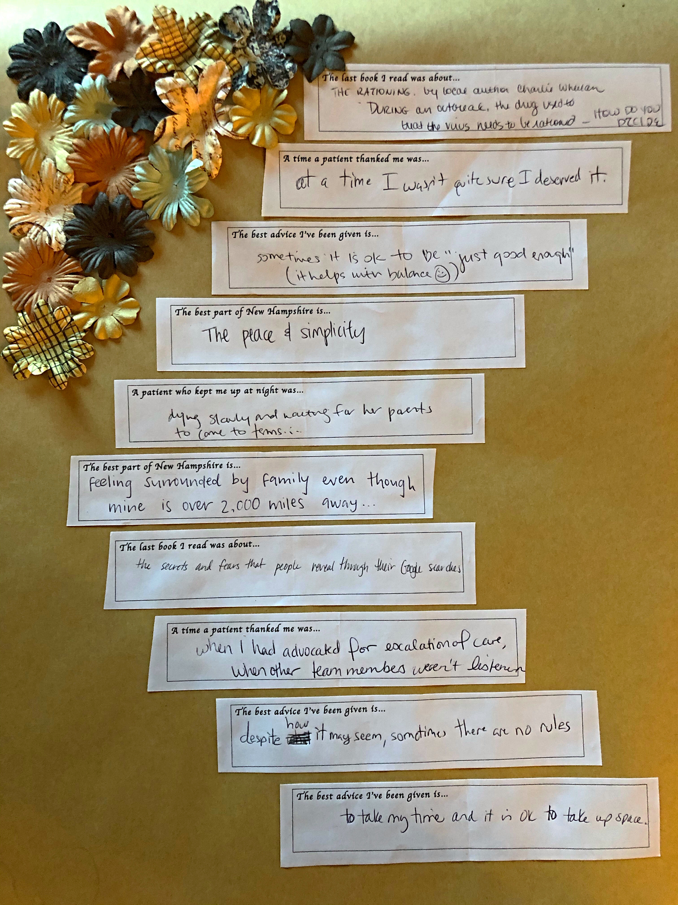
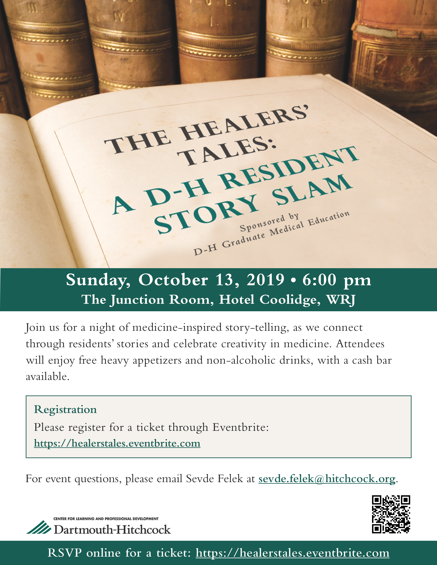
THE HEALERS’ TALES: A D-H STORY SLAM
Sevde Felek MD¹, Catherine Shubkin MD^{1,2}, Kelly Rose ¹
¹Department of Pediatrics, Children’s Hospital at Dartmouth-Hitchcock, ²Geisel School of Medicine at Dartmouth
BACKGROUND
THE STORIES
THE STORY SLAM
Narrative medicine is a rapidly-growing field in which healthcare providers share personal and patient stories to promote communication, understanding, and creativity in medicine.
The Metro Minnesota Council on Graduate Medical Education (GME) piloted its resident Story Slam in Fall 2018, at which participants shared their prepared stories.
Upon their success, a similar Dartmouth-Hitchcock (DH) resident, fellow, and medical student event was piloted.
“…I visited Ruth daily. On days she felt well, we sat in front of the common room’s windows and watched the leaves fall as she told me about Frank’s sins. On days she felt restless, we shuffled down the hallways together, and she told me about her mother... Some days, her delusions and hallucinations overpowered the effects of her medications, and on others, we only talked of the weather.”
Ruth, by Sevde Felek
“On week 3, you open your eyes and glance at your parents
Their smiles radiate sunbeams that dance across your face
Everyday you impress us by growing a few grams more
And your heart? Well it continues to soar.”
Thank You Note to a Preemie,
by Gabriela Ika Kovacikova
PLANNING
Funding applied to and granted by DH–GME office
Call for story submissions via DH-GME office, residency program coordinators, and Geisel’s Student Affairs office
Event location reserved
Submissions screened for HIPAA compliance
Ticketing process for event advertised
“I spend a lot of my days now agonizing over prognostication. How will I know what is going to happen to a patient? …When it comes down to the moment when a mother looks you in the eye and asks, ‘What is going to happen to my child?’ I’m stuck with the task of parsing the future.”
Prognostication Hesitation,
by Luke Lamar
DISCUSSION
Storytelling requires practice and training.
Story Slams can provide healthcare trainees a safe platform with which they can safely share their thoughts and exercise their creativity.
Limitations to collecting story submissions and drawing a larger audience include the busy schedules of students and residents.
Audience participation
FUTURE DIRECTIONS
“My mother told me that her only certainty in the cloud of
questions was holding me in her arms, feeling me squirm, and knowing that her only job was to navigate a way for me to grow up freely. That same sense of calm emanated from Shreya. The baby was a physical form of true promise of a beautiful future and reminded me of how daring each woman to choose this path for her life.”
Mirrors, by Shilpa Darivemula
Broadening participant perspective by including attendings, nurses, and social workers in Story Slams
Developing a systematic method of advertising to more storytellers and collecting submissions
Collaborating with New England-area residency programs for a greater width of story-sharing and qualitative research
Dartmouth-Hitchcock Arts and Humanities in Medicine Symposium, 2020
Sevde.Felek@Hitchcock.org

