Slide 1
Endocarditis Related to Injection Drug Use: Marker of an Epidemic
Colleen Kershaw, MD
Assistant Professor of Medicine
Jeffrey Parsonnet, MD
Associate Professor of Medicine
Dartmouth-Hitchcock Section of Infectious Disease and International Health

Slide 2
No conflicts of interest to disclose.

Slide 3
Case Presentation
29 y.o. female, transferred from OSH after presenting with chest pain, dyspnea, fever, starting about 3 days p.t.a.
History of injecting drug use, last injected heroin 6 days p.t.a
PMH negative except for untreated HCV infection
Multiple blood cultures positive for MRSA
Antibiotic therapy: vancomycin

Slide 4
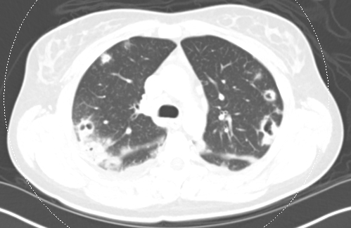
Case Presentation
Echocardiogram: Independently mobile, frond-like echodensities on TV, the largest 2 cm in length; severe TR.
CT scan:

Slide 5
Case Presentation
Persistently positive BCs after six days; switched from vancomycin to ceftaroline, with clearance of BCs.
Gradual improvement, ready for discharge by HD 13
Lengthy discussions about discharge options; decision made to discharge to home, with PICC line, on daily daptomycin.
Compliant with therapy, denied ongoing drug use.
Seen in ID Clinic at four-week point, doing well, therapy discontinued.

Slide 6
Case Presentation, Part 2
Readmitted three months later after presenting to OSH with chest pain, back pain, dyspnea.
Recurrent heroin use acknowledged
Multiple BCs positive for MSSA (new organism).
Echo: 2.7 cm vegetation on TV, 4+ tricuspid regurgitation

Slide 7
Case Presentation, Part 2
Hospital course complicated by respiratory failure, AKI, pneumothorax, severe hypotension, DIC.
Treatment involved CRRT, chest tube placement, antibiotics (cefazolin), vasopressors, prolonged intubation
MRI scan: discitis/osteomyelitis cervical and thoracic spine
Developed severe right heart failure, underwent TV replacement at week 6 of hospitalization
Hospital stay 10 weeks, discharged to home on methadone, with scheduled appointment in methadone clinic
Doing well, sober, 5 months after discharge (4 months ago)

Slide 8
Description of Patients, PWID with Endocarditis 2/2018 – 2/2019
39 cases of endocarditis, 38 patients (one with two discrete episodes)
14 male, 24 female
Average age 34, median age 31 (range 20-57)
84% (!) of patients infected with HCV (31 of 37 tested)
No patients with HIV infection (0 of 36 tested)

Slide 10
Valve Involvement
One prosthetic MV
One with AV
One prosthetic TV
Three with AV
One with MV
One prosthetic AV
Three with TV
One with MV

Slide 11
Microbiology of Endocarditis
Organism | Number of Patients
Methicillin-resistant S. aureus | 23
Methicillin-susceptible S. aureus | 11
Enterococcus faecalis | 1
Candida tropicalis | 1
Gram-positive cocci (on stain of valve) | 1
Unknown (C. albicans in one BC) | 2
62%

Slide 12
In-Hospital Complications
Septic shock
Lung abscesses
Pulmonary empyema
Massive hemoptysis
Congestive heart failure
Stroke
CNS hemorrhage
Mycotic aneurysm
Osteomyelitis, esp. vertebral
Septic arthritis
Acute renal insufficiency
Need for valve replacement (7 cases: TV 3, AV 2, MV 1, AV and TV 1)
Death (8 patients, 21%)

Slide 13
Completion of Therapy
Completion of Therapy Arrangements | # of Patients | Comments
Full course of IV therapy at DHMC | 11 | Range 4 to 10 weeks
Complete IV therapy at outside facility | 8 | Outside hospital, SNF, rehab facility, jail
Home with PICC line for IV therapy | 2 | No known violation of lines
Home on oral therapy | 6 | Mainly for patients leaving AMA
Home with weekly dalbavancin | 5 | Via peripheral line, infusion suite
Died in the hospital | 7

Slide 14
Status as of April, 2019
Eight deaths: seven in-house, one after discharge

Slide 15
IE Cases by Year
All IE cases at DHMC
Slide Courtesy of Drs. David DeGijsel and Martha Desbiens

Slide 16
IE Cases by Year
No substance use
Substance use by discharge diagnosis
Slide Courtesy of Drs. David DeGijsel and Martha Desbiens

Slide 17
IE Cases by Year
No substance use
Substance use by discharge diagnosis
Substance use by composite
Slide Courtesy of Drs. David DeGijsel and Martha Desbiens

Slide 18
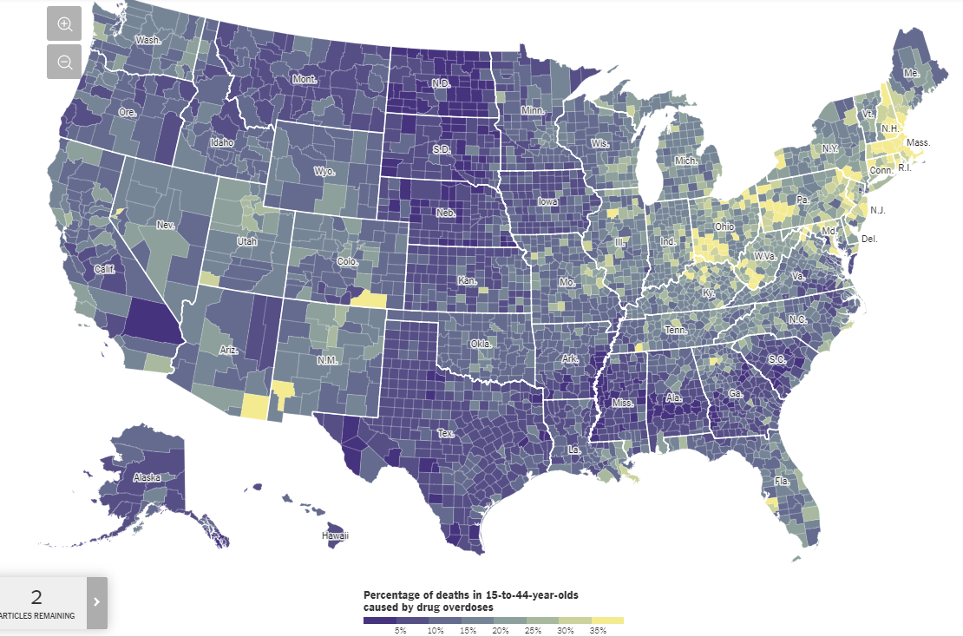
https://www.nytimes.com/interactive/2017/04/14/upshot/drug-overdose-epidemic-you-draw-it.html
www.nytimes.com
Notes:
January 2017-March 2019:
82 endocarditis cases
35 cases related to injection drug use (~43%)

Slide 19
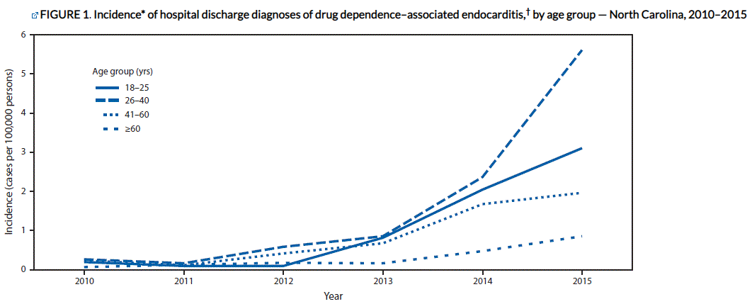
The estimated incidence of IE in PWID is
Incidence in the general population.
50-100 x
Fleischauer, et al. MMWR Morb Mortal Wkly Rep 2017.
Notes:
The estimated incidence of endocarditis in PWID is 50-100 times that of the general population. We are seeing the effects of this linked to the increased incidence and prevalence of opioid use and other substance use disorders with injection drug use via significant increases in the numbers of IDU related IE. This report from North Carolina is quite striking.
Rates of hospital admissions for drug dependence–associated endocarditis increased approximately twelvefold in the state of NC, from 0.2 cases per 100,000 persons per year in 2010 to 2.7 cases per 100,000 persons in 2015. The sharpest rate of increase occurred among persons aged 18–25 years (IRR 2.1; 95% confidence intervals [CI] = 1.4–3.1
2/3 aged ≤40 years, ½ aged 26–40 years.
Patients were mostly white (87%) and non-Hispanic (92%)
(60%) were from rural counties.
HIV coinfections uncommon (1.4%)
36% of patients with endocarditis had past or current HCV infections.
Estimated incidence of IE in PWID:
100-400/100,000 person-years.

Slide 20
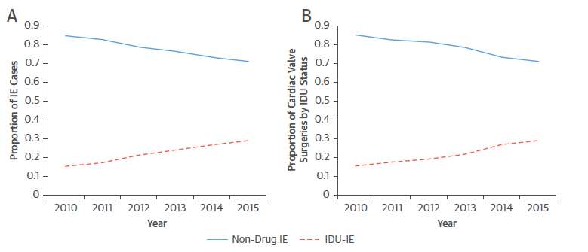
90%
Rudasill et al. JACC 2019
Notes:
Retrospective study of national readmission database Jan 2010-Sept 2015 (56% of US hospitalizations)
Proportion of IDU-IE went from 15.3% in 2010 to 29% in 2015—representing an increase of 90%!
Readmission w/in 30d
Readmission w/in 180d
Mortality
LOS
Total adjusted costs
Discharge location at index hospitalization

Slide 21
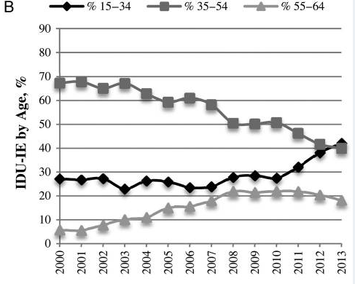
Epidemic of the Young
 | IE in PWID N=27,432 | IE in non-PWID N=96,344
Mean Age | 38.3 | 50.7
Rudasill et al. JACC 2019
Wurcel, et al. OFID 2016.

Slide 22
What happens to these patients?
Longer hospital stays
Notes:
Discuss withdrawal w/AMA?

Slide 23
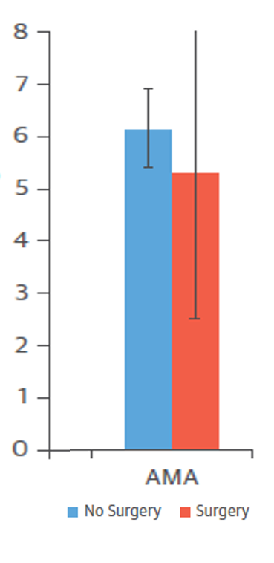
What happens to these patients?
Longer hospital stays
Many leave AMA:
4-17%
Difference between patients undergoing surgery vs. not
Rudasill, et al. JACC 2019.
Rosenthal, et al. Am J Med 2016.
Gray et al. BMC Infect Dis 2018.
Notes:
Discuss withdrawal w/AMA?

Slide 24
What happens to these patients?
Longer hospital stays
Many leave AMA
Few go home with IV
antibiotics/home health care
Rudasill et al. JACC 2019
Notes:
2019 retrospective study 2010-2015 of National Readmissions Database (56% of US admissions)
PWID less likely to be discharged home; more likely SNF
Represents overall readmissions

Slide 25
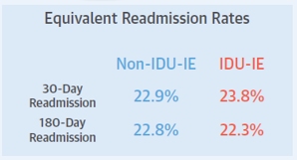
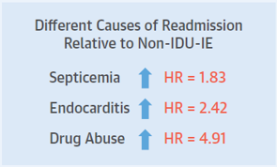
What happens to these patients?
Longer hospital stays
Many leave AMA
Few go home with IV antibiotics/home health care
Mixed data on readmissions, with caveats
Notes:
Rosenthal, et al 2016: 49% at some point within 10-year study period
Gray, et al 2018: 22.4% within 6 months
Rudasill, et al 2019: 22.3% within 6 months

Slide 26
What happens to these patients?
Longer hospital stays
Many leave AMA
Few go home with IV antibiotics/home health care
Mixed data on readmissions, with caveats
Overall mortality?
Notes:
Discuss withdrawal w/AMA?

Slide 27
 | N | Mortality | Comparison to non-PWID
BIDMC¹ 2004-2014 | 102 | 25.5% (during study period 10yrs)
UVA² 2006-2016 | 76 | 21.8% (90d) | No difference w/ non-PWID-IE cohort
DHMC 2018-2019 | 38 | 21% (during study period 1yr)
National Readmissions Database³ 2010-2015 | 27,432 | 6.8% (not clearly defined) | 9.6%
.
1. Rosenthal, et al. Am J Med 2016.
2. Gray et al. BMC Infect Dis 2018.
3. Rudasill, et al. JACC 2019.
Notes:
Previous evidence suggested mortality generally lower in IDU-IE than IE associated with other causes: 10% vs. 20-35%
However, this is changing: most recent studies suggest that mortality in IDU-IE vs. non-IDU-IE is similar, despite younger age and fewer comorbidities in PWID
UVA readmissions at 6 months, BIDMC during study period, UCSF during study period

Slide 28
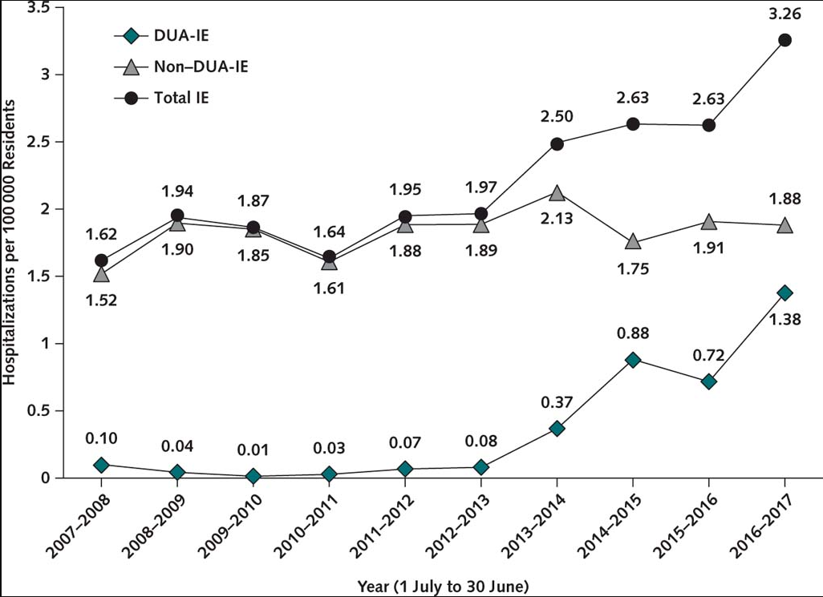
What about surgery?
12x
Schranz, et al. Ann Intern Med 2019.
Notes:
OF NOTE: 15-year reoperation risk due to PV degeneration normally is 30% for 40yo and 50% for 20yo—therefore many patients requiring surgery will require additional valve replacements!
Last year of study: IDU-IE surgeries accounted for 42% of all IE surgeries
North Carolina
Retrospective NC discharge database 2007-2017
22825 IE overall
2602 DUA-IE
285 surgery hospitalizations for DUA-IE
Among IDU-related IE requiring surgery, 38% Medicaid, 35% uninsured vs non-IDU Medicare 42% or private insurance 31%...say something about this?
Surgery addressed:
AV 55%
MV 47%
TV 16% (involved much more often for IDU related than not)
Multiple valves 20%
IDU longer stays 11 vs 7d
IDU fewer home discharges
Inpatient mortality lower in IDU: 8 vs 14%
AMA 13% IDU vs 1% non-IDU
If pt had surgery, IDU stay 27d vs 17d non-IDU
Overall Hospital charges higher for DUE-IE than non: $60333 vs $34698 BUT surgical hospitalizations non-IDU was higher

Slide 29
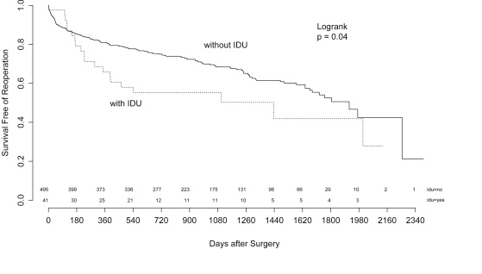
Outcomes in PWID requiring surgery for IE
3-6 months after surgery, PWID were
More likely to die or require re-operation
10x
Shrestha, et al. Ann Thorac Surg. 2015
Notes:
Cohort of PWID requiring surgical intervention for endocarditis from 2007-2012 at the Cleveland Clinic
At 3-6 months postoperatively: HR 9.8 for death or reoperation among PWID vs. patients with no history of injection drug use

Slide 30
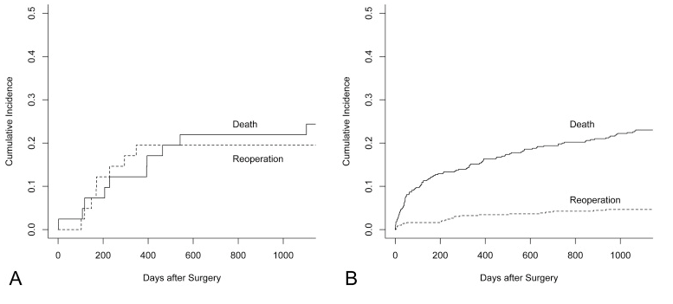
HR 3.8 for valve-related complications
HR 6.2 for reinfection
PWID
Non-PWID
Mean age 38 + 11
Mean age 59 + 14
Shrestha, et al. Ann Thorac Surg. 2015
Kim, et al. J Thorac Cardiovasc Surg 2016.
Notes:
FOCUS ON RECURRENT DISEASE AND NEED FOR REPEAT SURGERY!
Estimates in general of recurrent IE after surgery for PWID-IE are 13-52% at 18-32 months. (small studies)
Mortality did not differ between PWID and non PWID, but risk/rate of reoperation did.
I do want you to notice the mean ages here. PWID were only 38, vs their counterparts at 59.

Slide 31
What are we missing?

Slide 32
Addressing addiction: essential and missed opportunities
No naloxone prescriptions provided
49% readmitted
Of which: 28/50 (56%) had ongoing documented active injection drug use
7.3% of IDU-IE patients in national database readmitted within 180 days explicitly for “drug abuse”
1. Rosenthal, et al. Am J Med 2016.
2. Gray et al. BMC Infect Dis 2018.
Notes:
BIDMC 2004-2014 IDU-IE cases
No naloxone prescriptions
49% readmitted
Of those, active injection drug use documented in 28/50 patients (56%)

Slide 33
Addressing addiction: essential and missed opportunities
Jicha, et al. J Addict Med 2019
Notes:
Retrospective review of 108 patients at UKY looking at addiction interventions in people with SUD and infection 2012-2015.

Slide 34
What strategies have you found particularly helpful to providing comprehensive
medical management to PWID?
“It sucks, nothing works, I have treated entire addicted families. Thinking of quitting. 50% of my infected inpatients today were heroin related.”
Infectious Diseases Society of America Emerging Infections Network Report for Query: ‘Injection Drug Use (IDU) and Infectious Disease Practice.’ Courtesy of Christopher Rowley.
Notes:
We know from national databases that Hospitalizations due to serious infections, including endocarditis, epidural abscess, septic arthritis, osteomyelitis related to OUD have been rising quickly, and nearly doubled between 2002 and 2012. This has meant an influx of patients and infections.
Recently, one of my mentors and a colleague created a survey of ID providers across the country through the IDSA Emerging Infections Network, to get an idea of what ID docs out there are seeing in terms of infectious complications of injection drug use. In a free text response to one of the questions, a distraught ID provider from Ohio gave this powerful quote:…
This is a sad and dire state of affairs. Today, I’d like to try to make a shift from this feeling of despair, to think about some hope and what we might do to think a little more creatively, and to consider some innovative solutions for patients with acute infections secondary to injection drug use, with a focus on those who need long-term antibioitcs.

Slide 35
How do we move forward?

Slide 36
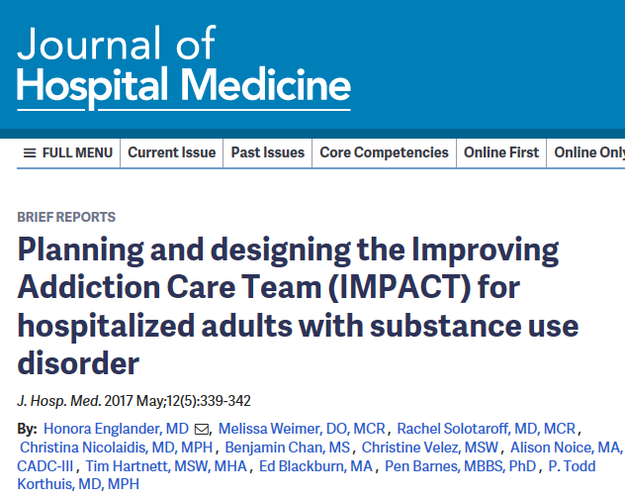
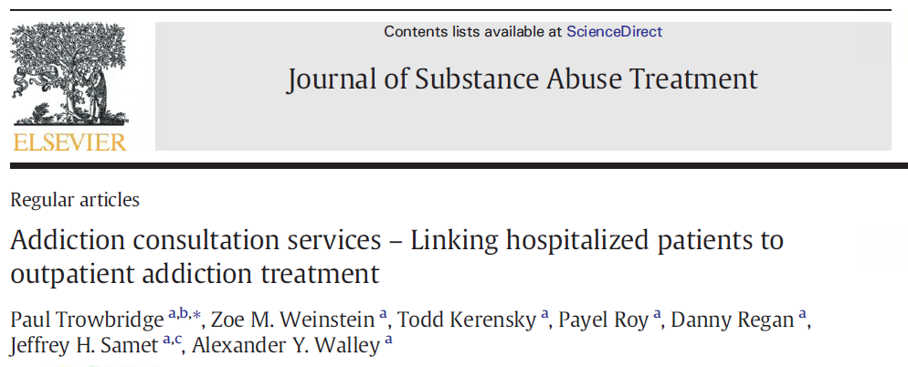
Models for Integrating Addiction Care
Notes:
Several years ago various innovative hospital systems throughout the country began trying new ways to address addiction care during the hospitalization
2014-2015
Partnership and financial support from Community Care Organizations (Medicaid) and hospital due to potential for:
Decreased costs
Decreased LOS

Slide 37
BITeam at DHMC: Trying to take a multi-tiered approach
Early identification
Management of withdrawal symptoms
Therapeutic interventions during inpatient hospitalization
Relapse Prevention
Slide Courtesy of Christine Finn, MD

Slide 38
Choosing therapy for the infection: Can we use a PICC line?

Slide 39
Infectious Diseases Society of America Emerging Infections Network Report for Query: ‘Injection Drug Use (IDU) and Infectious Disease Practice.’ Courtesy of Christopher Rowley.

Slide 40
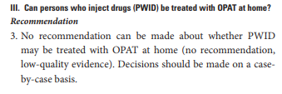
UNHELPFUL

Slide 41
Current practice: Evidence-based, or Dogma?
Few studies
Mostly retrospective and relatively small
Mostly without comparison groups
Diverse in delivery methods of OPAT
Most do not report if (and how) patients received treatment for underlying substance use disorder
Most do not report on outcomes related to substance use disorder
Lack of long-term follow up
Some findings contradictory or not replicated
Notes:
Hard to draw real conclusions because:

Slide 42
General Findings
 | PWID | General OPAT Population | Verdict?
Successful completion of antibiotic course | 72-100% | 80-90%
IV line complications | 0.75-4.2/1000 line days | 3.2-5.3/1000 line days
Readmissions | 0.6-41% (most >20%) | 3.6-12.6% Endocarditis: 16% Bone/joint: 36% (DHMC: ~15%)
Mortality | Most 0; highest 10.3% | 0.1-0.4%
Relapse of SUD | Most studies do not report
?
?
Suzuki, et al. OFID 2018.
Notes:
10 studies, 3 prospective, 7 retrospective. 1 retrospective and 2 prospective with comparison groups.
PICC misuse documented in 1 study at 2%, otherwise no comments about patients actually using the PICC to inject.
No differences in line infections in the studies that compared PWID vs not
Importantly, studies that had mortality >0 either didn’t specify cause of death, or in 1 study, specified that it was not related to OPAT
But A more recent study by D’Couto looked retrospectively at pts with h/o IDU discharged w/PICC, most PWID went to facilities, compared home (21 pts) vs. SNF (31), pts going to SNF more likely to have ongoing use, did find high rate of complications among PWID especially in SNFs (35%) vs 19% dc’d home, 1 of which at home was line infection thought 2/2 relapse with IDU (5%). In SNF there were 3 patients thought to have line infection which was a different organism than their original infection, suggesting relapse of IDU. Only 1 line complication in person dc’d home (less ongoing IDU).
But the big caveat with that study is that very few patients overall, and more in the SNF group which had ongoing drug use, were offered any form of substance use treatment—only 16%.
Bloodstream infections were documented in several studies—but not clear whether this involved the PICC line itself (Ocallaghan 2019—4/38, 11%, poymicrobial growth not consistent with prior cultures, 2 admitted to injecting use of non-prescribed agent through PICC; no deaths)

Slide 43
Beyond the PICC line: Individualized Care & Addiction Treatment
Risk Factor | Score (0-1)
1. Cravings
2. Unstable home environment
3. Dual Psychiatric diagnosis
4. History of drug overdose
5. History of multiple relapses
6. Polysubstance abuse
7. Family history of addiction
8. History of Trauma
9. Limited willingness to change
UAB Intravenous Antibiotics and Addiction Team: “IVAT”
Mild risk: score of 1-3
Moderate risk: score of 4-6
High risk: score of ≥ 7
Eaton, et al. IDWeek Abstract 2018.
Notes:
Trend is individualized care based around risk assessment. Some patients, even those who do not have a history of substance use with injection, are not appropriate candidates for OPAT. New approaches regarding patients who inject drugs include working with addiction and psychiatry teams and most importantly thinking about their overall risk factors for success. Several iterations of this including older studies which put anyone with any recent or ongoing use in the highest risk category which indicated no possibility of IV antibiotics outside the hospital, which is not realistic in our times and would not solve the problem we currently are facing. However none yet clearly shown to be predictive except a trend towards the longer since the person has used. Therefore right now we are making it up as we go.
UAB Intravenous Antibiotics and Addiction Team (IVAT)
“Low-risk” patients (1–3 points) are discharged for the duration
of antibiotics and participation in outpatient addiction care.
“Medium-risk” and “high-risk” patients (4–6 and 7–9 points,
respectively) are kept as inpatients and offered group therapy,
opioid agonist therapy (if applicable), and assessment for discharge
Readiness
Pre-post risk assessment implementation, there was no change in AMAs or readmissions, but there was a reduction in LOS and hospital costs
Pre-post design

Slide 44
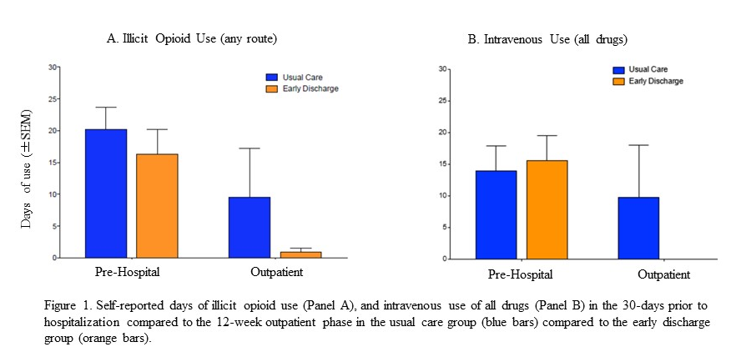
New Approaches: Keep Calm and OPAT On (As long as you treat the addiction)
Fanucchi, et al. Oral presentation, IDWeek 2018 and personal communication 3/2019.
Notes:
Some providers have been a little more brave. This is a pilot study out of the University of Kentucky by Laura Fanucchi and colleagues, who performed an RCT comparing a small group of PWID who got “usual care”—ie, long-term antibiotics in the hospital, vs. early discharge. Rather than looking at the time since last use of injection drugs, They only excluded patients who were homeless, lived farther than 45 min away, were incarcerated, who had PVE or fungal endocarditis, or who had very complicated medical problems including CHF, stroke, ESRD, cirrhosis, and also patients with severe stimulant, benzo or alcohol use disorders felt to complicate the picture further.
There were 10 in each group. All patients in both groups received inpatient buprenorphine and then 3 months of intensive addiction care with bup and counseling, in an integrated program where they were seen 1-3 times per week by addiction providers, and at usual intervals by ID providers. There was a significant decrease in opioid use by both groups after discharge, and more so in the group who was early discharge. There was no reported IV drug use among patients in the early discharge group once they were outpatient.
There were no problems with the PICC lines themselves, and only 1 readmission which was due to an infusion company not delivering the antibiotic on the right day.
The U KY group is moving on now to a larger study to confirm these findings. I think the takeway here is that there was treatment of the addiction—without that piece, the investigators felt this practice was unlikely to succeed.
All patients seen 3x/week by addiction providers
Excellent retention while PICC was in
Exclusions: homeless, lived farther than 45min,
Severe stimulant, benzo, or alcohol use disorder
Stroke, CHF, ESRD, cirrhosis
Prosthetic or fungal endocarditis
Incarceration
Pregnancy
Had reduced LOS

Slide 45
More Evidence Coming Soon
BWH Multidisciplinary ID & Addiction Consult teams assessment
Considered for IV antibiotics @ home if:
Safe housing, w/o cohabitants currently using drugs
Patient engages in treatment for SUD and initiates during hospital stay
Not engaging in substance use or violent behavior once receiving appropriate care for SUD
Agrees to return to Bridge Clinic and OPAT care
Since April 2018:
15 completed
1 readmitted
Saved over 400 inpatient days
Positive feedback from nursing staff
No issues with PICC lines
Personal communications with Dr. Daniel Solomon and Dr. Joji Suzuki, 3/2019.
Notes:
Bridge clinic 2x/week

Slide 46
Future directions at DHMC: “Cura Personalis”
ID, GIM, and BITeam Collaboration
Developing:
Protocol for multidisciplinary teamwork, assessment, and linkage to outpatient addiction treatment post-discharge
General guidelines for patients in whom home IV antibiotics could be reasonably considered
Possible new pathways for patients who do not have addiction care providers in the community

Slide 47
From Despair to Hope
“Compassion”
“Empathy”
Infectious Diseases Society of America Emerging Infections Network Report for Query: ‘Injection Drug Use (IDU) and Infectious Disease Practice.’ Courtesy of Christopher Rowley.
Notes:
In closing, I wanted to leave you with some of the other quotes from the EIN survey, which provide hope by showing what some of our ID colleagues have said are effective ways that they have found to help patients who have opioid use disorder complicated by acute infections. They are often taking an active role in finding ways to treat the whole person.
Compassion, empathy: these are our core values as physicians, and particularly infectious disease physicians. I thank you for your time, and want to thank several of my colleagues for their significant contributions and mentorship in this area. I am happy to take any questions.

Slide 48
Thank You
Chris Finn
David DeGijsel
Martha Desbiens
Charlie Brackett
Elias Loukas

