Slide 1
Dartmouth Hitchcock Initiatives to Optimize Care of
Patients with Opioid Use Disorders & Reduce Opioid Related Harm
Monday, March 4th, 2019 5:00 to 6:30 pm, DHMC Auditorium H
Meeting goals
Update D-H staff and others with interest on recent advances within D-HH to improve care of patients with OUD/SUD and reduce opioid related harm
Inventory any unidentified or persisting challenges related to care of patients with OUD and/or other initiatives
Identify opportunities to expand engagement
Program:
Welcome & introductions (3 min)
Evolving Contextual Changes (10 min)
D-H initiatives addressing OUD and harmful opioid use (Total 55 min: 5 min each, except OATC 15 min & transition time)
Discussion (25 minutes)
Final comments and plan next meeting (2 minutes)

Slide 2
Introduction
Please send your contact information to ariel.a.pike@hitchcock.org if you are not attending in person.

Slide 3
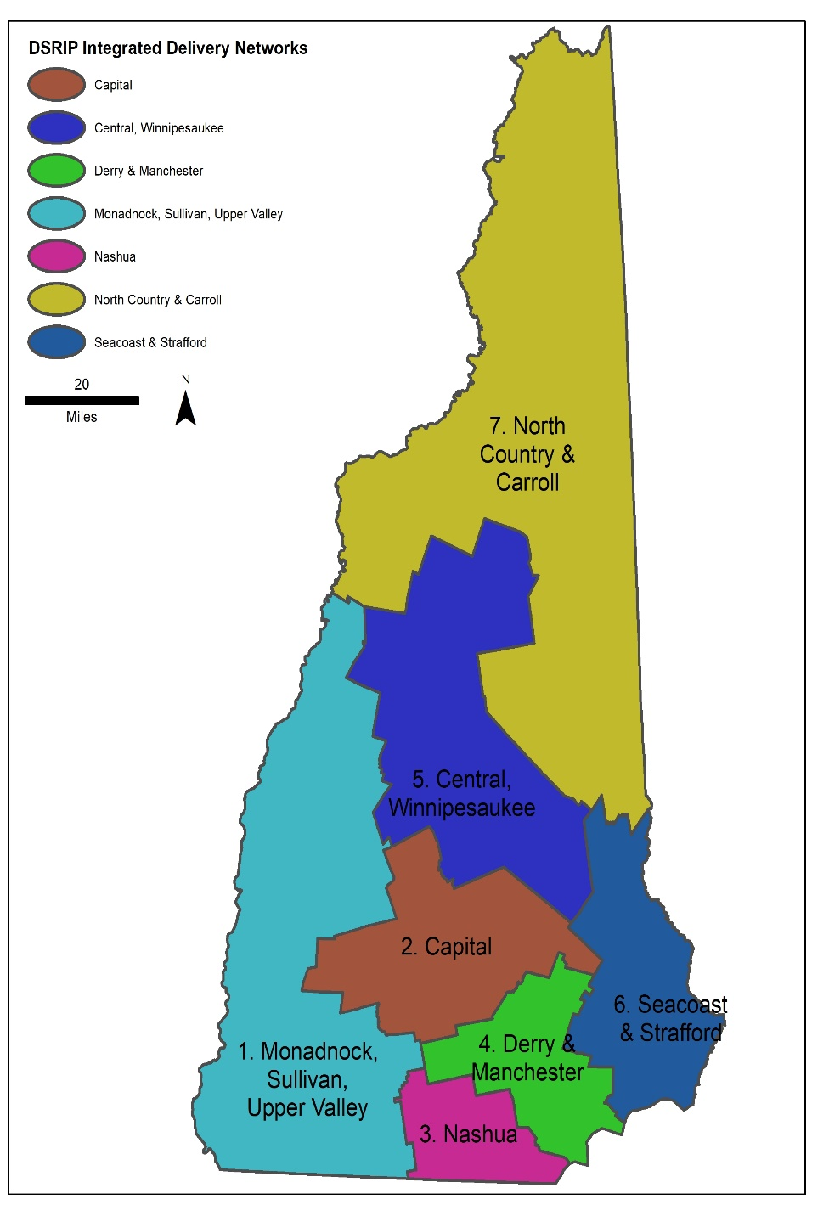
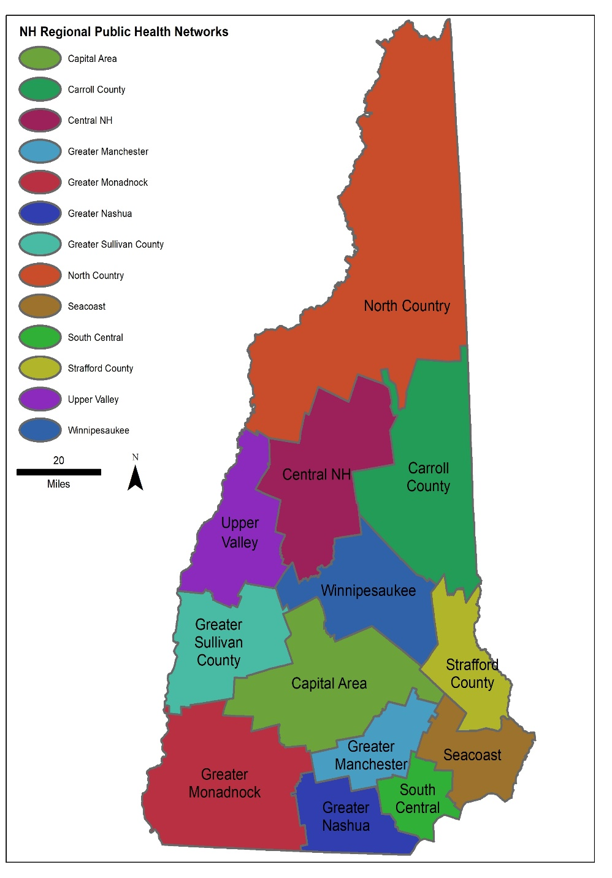
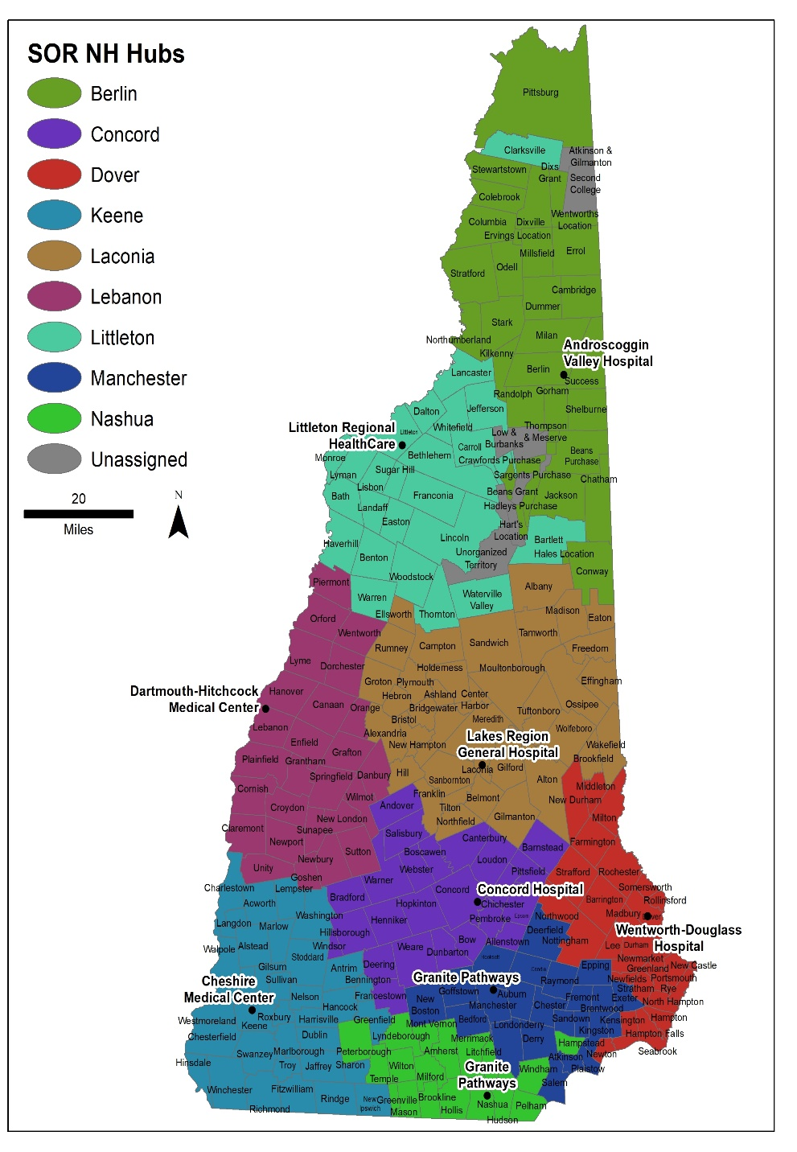
NH Medicaid Delivery System Reform Incentive Program. D-H and Cheshire Medical are Region 1 leads.
NH Regional Public Health Networks. D-H supports Upper Valley and Greater Sullivan networks.
NH Doorways program (Hub and Spoke). D-H Lebanon is a hub.

Slide 4
For more information:
http://region1idn.org/2017/04/10/about-1-nh1115.html

Slide 5

NH Hub and Spoke:
The Doorway at DHMC-Lebanon

Slide 6

Introducing The Doorway
Shared access point: substance use treatment, recovery, support, and information
Clients and their families can call 2-1-1 anytime to connect

Slide 7


The Doorway
Peer Recovery
Housing & Shelter
SUD Treatment & MAT
Mental Health
Primary Care
Social Services
Employ-ment
Education
Goals:
Identify client needs and resources then help clients connect with appropriate substance use disorder treatment, recovery, and supports
Coordinate care & support throughout recovery

Slide 8

General Process Flow
After-Hours Hub
Assessment, information, referral
After Hours
Yes
Call
2-1-1
Information from assessment is sent to local Hub with appropriate security
Person seeks treatment
No
Patient referred to Local Hub
Assessment, evaluation, referral

Slide 9
DHMC Role
Addiction Treatment Program: The Doorway (Hub)
Providing Clinician After Hours Telephone Service

Slide 10
Our Purpose is to Bolster and Mobilize Resources for Recovery
DHMC-Lebanon Hub:
  Improves Access By Adding A Treatment and Recovery Entry Point and After Hours Call Service via 2-1-1
  Will Begin to Formalize our Collective Community of Available Resources
Remember “No Wrong Door” - Clients Can Still Seek Help Anywhere
We Are In the Startup Phase – Learning and Building In Concert with Our Community and the State

Slide 11
Opioid Addiction Treatment Collaborative (OATC) at D-H
Charles Brackett, MD, MPH
Laura Fineberg, MPH
Notes:
Historically- treatment of addiction has been largely separate from mainstream medical care; OATC started ~1 yr ago w over arching goal of improving Recognition of OUD and Delivery of treatment in general medical settings; Move addiction treatment into mainstream clinical care- more accessible and better able to capture reachable moments to intervene

Slide 12
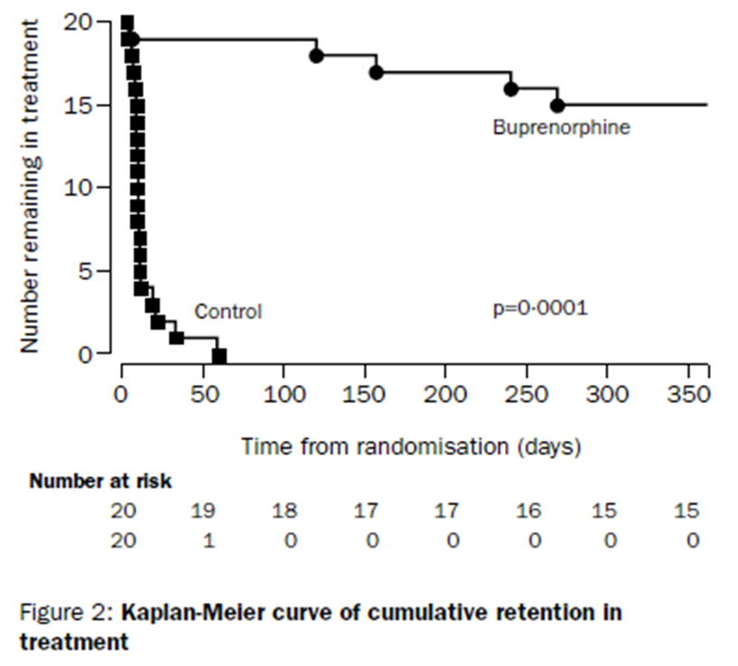
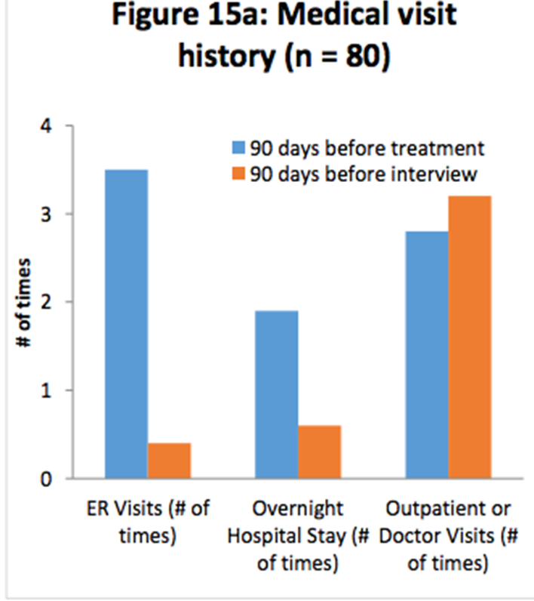
Background
Opioid addiction is a common treatable chronic disease, but is often not addressed by clinicians
Treatment including FDA approved medications is highly effective, but is only received by a minority of those with OUD. Barriers include: inadequate recognition, shortage of specialists, financial and logistical barriers, and stigma
Starting buprenorphine on inpatients with OUD reduces disruptive behavior and AMA, and improves engagement in ongoing treatment. Starting in ED also improves engagement
Many patients can be treated in primary care, which reduces stigma and increases access and care coordination.
Notes:
-not willful misbehavior or a moral failing
due to inadequate training and knowledge, bias, stigma and lack of ownership. Diabetes.
These barriers can be addressed by mainstreaming OUD treatment into general medical settings
-EBM: PAP vs mat- counseling is important, but shouldn’t be a precondition for medication.
OAT: 70% reduction in all cause mortality

Slide 13
Goals of OATC
Increase understanding that OUD is a treatable chronic disease that should be addressed without judgement or stigma
Identify inpatients with OUD and encourage initiation of medication and counseling during the admission
Identify ED patients with OUD and initiate medication
Develop a referral network of treatment programs and community supports ready to receive patients initiated on medication in a timely fashion
Mainstream multi-disciplinary treatment of OUD into D-H primary care through expansion of the Collaborative Care Model

Slide 14
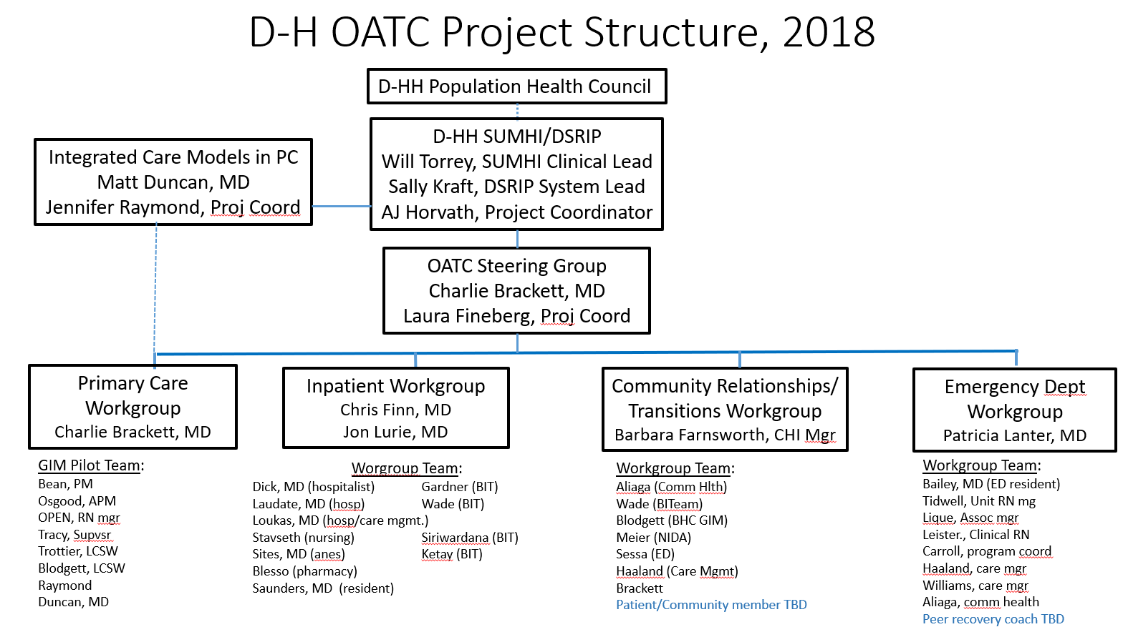

Slide 15
OATC Leadership and Steering Committee
Work across silos, coordinate workgroups, ATP and other OUD projects
eDH tools
  Inpatient and ED buprenorphine initiation order sets, revised inpatient order
  Smartsets for primary care and ED discharge
  Buprenorphine navigator
  Note templates
Policy: Bup updated; addition of Vivitrol to formulary, policy approved
Consent/treatment agreements for bup and naltrexone in consent library
Waiver training/tracking
Coordinate with Education/Training (Seddon)
Value stream mapping
Metrics
Notes:
Laura and I are resources, building the behind the scenes infrastructure needed
All interns and almost all residents have received online waiver training

Slide 16
Referral Relationships
Inpatient Unit
(BITeam)
ED
(recovery coaches)
*Triage Criteria
Geography
Insurance
Severity of Addiction
Co-morbidities
Patient Preference
Tx Matching
Referral/
Triage*
Stable Patients
Other Community MAT agencies
ATP
(Hub)
Complex Patients
DHMC
Primary Care
(GIM, HTR)

Slide 17
Primary Care Workgroup
Guideline: Primary Care Treatment of OUD
GIM 3M pilot has been live for 1.5 years
  Collaborative Care Model- shared care between physician and BHC
  MA role: UDT, PDMP, BAM questionnaire
  Referral relationship with ATP
  Monthly implementation meeting: workflows, problem solving
  Monthly clinician meeting
Heater Road
Southern Primary Care sites incorporating MAT into rollout of BHI
  BHCs being onboarded, trained in MAT 1/30
Screening piloted at Nashua FM and Heater- to roll out broadly

Slide 18
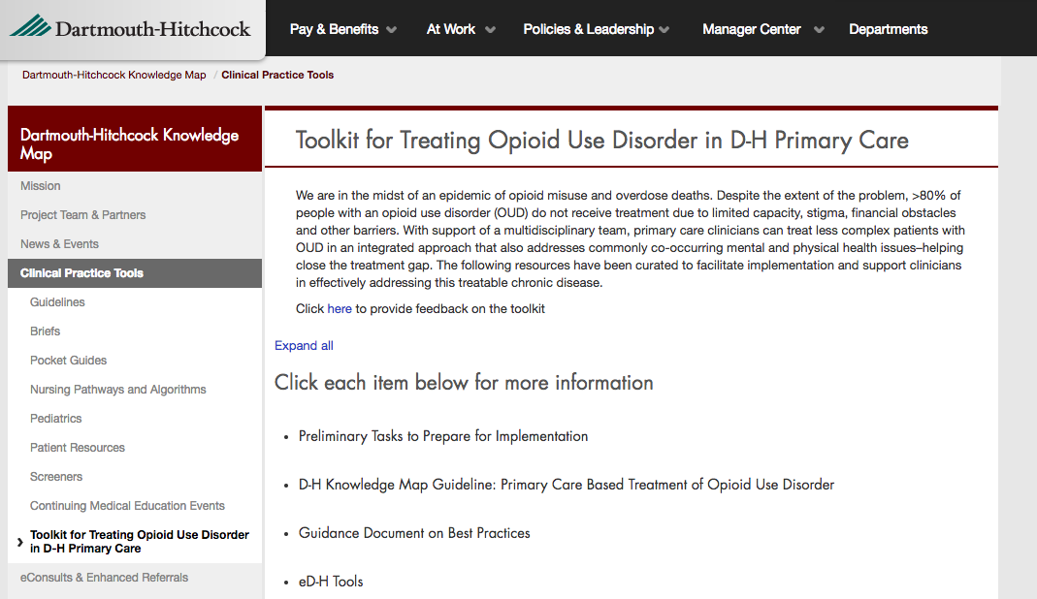

Slide 19
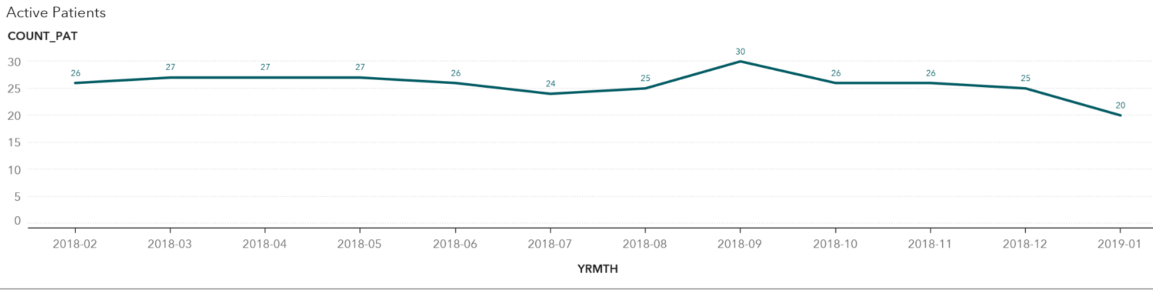
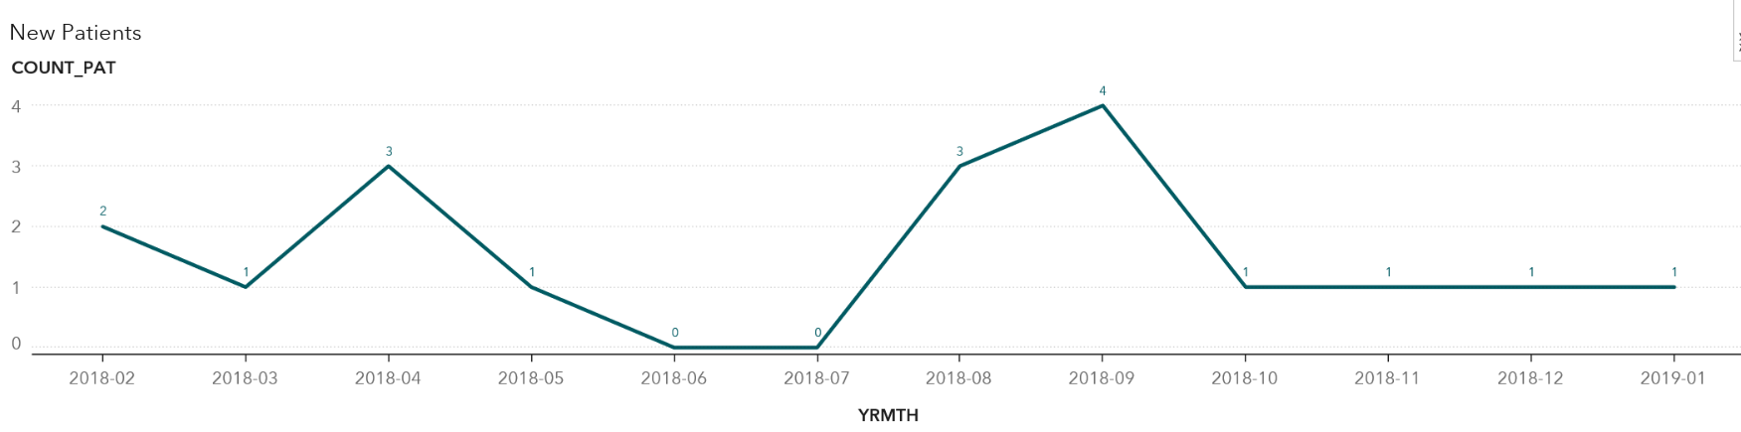
Primary Care – Leb GIM

Slide 20
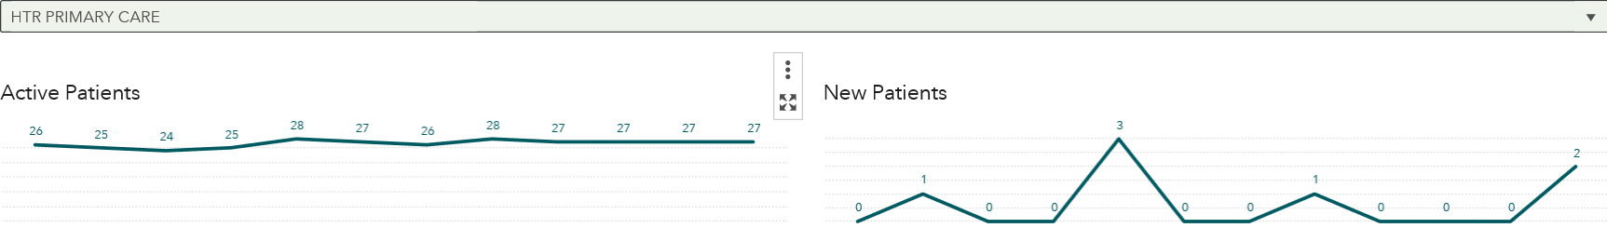
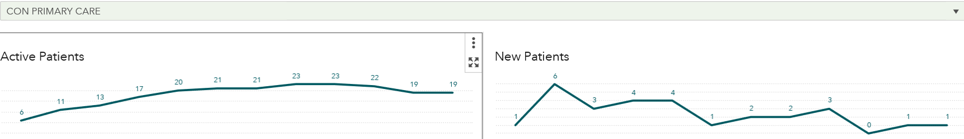
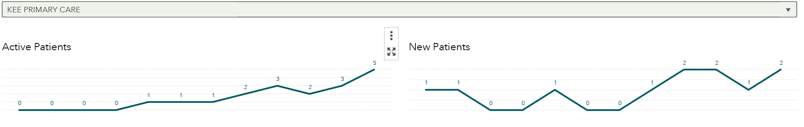
Primary Care
Notes:
Lou Kazal, Alena Shoemaker, Matt Mackwood
Sandy Bell
Manchester Nashua- gearing up

Slide 21
Inpatient Workgroup:
Early identification: Screening for alcohol and drug use on admission by nurse. +screens reviewed by BITeam
  Screening live on: 1E, 2E, 3E, 3W, ISCU (12/3/18)
  % eligible screened: 65, 63, 79, 43 (goal >70%)
  Next up: Cardiology
Management of withdrawal symptoms
  Encourage use of buprenorphine early and often (order set)
Therapeutic interventions during inpatient hospitalization
  MI, supportive therapy, diagnosis and management of comorbid psych
Relapse Prevention
  Initiation of MAT, connection with outpatient follow-up
Facilitate successful OPAT in IDU related infections
Notes:
Last measurement period. Initial higher success.
Colleen Kershaw

Slide 22
Initiation of buprenorphine on the Inpatient service
YRMONTH | ORDSET | DISCH_NEW_MED | QUEST_ANS_THISADM | TCNT
2018-01 | 0 | 1 | 0 | 1
2018-02 | 0 | 3 | 0 | 3
2018-04 | 2 | 1 | 0 | 3
2018-07 | 1 | 2 | 0 | 3
2018-08 | 1 | 1 | 0 | 2
2018-09 | 1 | 2 | 0 | 3
2018-10 | 2 | 2 | 0 | 4
2018-11 | 7 | 1 | 0 | 8
2018-12 | 2 | 3 | 0 | 5
2019-01 | 5 | 1 | 1 | 7
Notes:
New order set 7/18,
Hosp meetings 7/31/18, 11/13/18, 3/12/19; BITeam templates to collect data

Slide 23
Emergency Department
Working on increasing # of waivered clinicians
  Went from 2 waivered providers to 8 (out of 17)
Success at reducing stigma, increasing acceptance of MAT
  Education sessions for clinicians, nurses, LNA/MAs
Refining workflows and the Peer Recovery Coach role
Initiate MAT at Cheshire ED

Slide 24
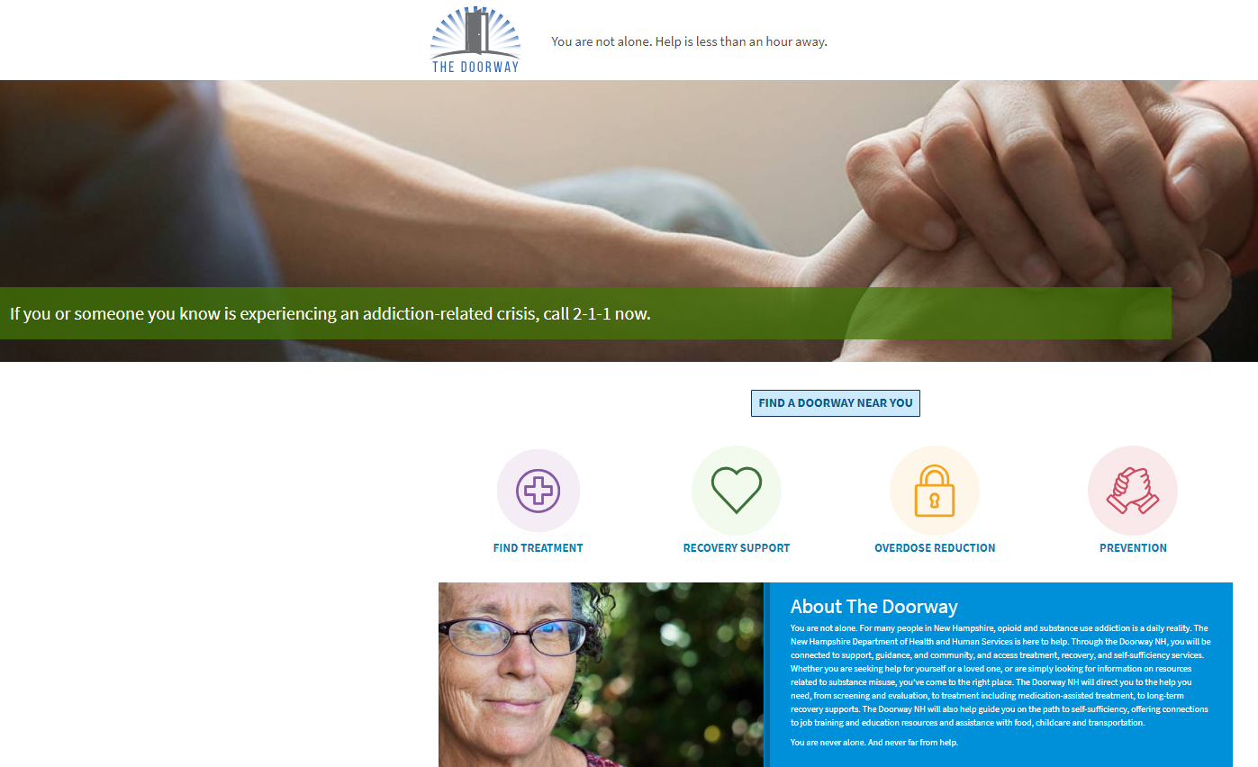
Transitions Workgroup: Transitioning to Doorway-Spokes Relationships
Notes:
Last week decided to put on hold as the
Bridget Aliaga and Barbara Farnsworth- warm hand offs timely access to continue bup started inpt/ED

Slide 25
Summary of D-H Waivered Providers by month
Month | Mar 2018 | Apr 2018 | May 2018 | Jun 2018 | July 2018 | Aug 2018 | Sept 2018 | Oct 2018 | Nov 2018 | Dec 2018 | Jan 2019 | Feb 2019
Total # of D-HH Providers with X- Waiver | 39 | 44 | 46 | No report | 55 | 58 | 76 | 77 | 80 | 80 | 84 | 88

Slide 26
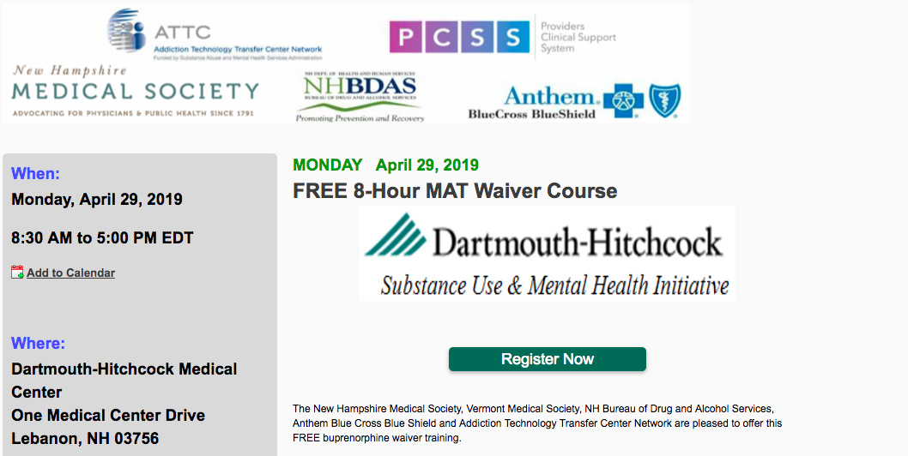
Notes:
Cheshire 5/16; free online training PCSS-NOW Sanjit Maruti

Slide 27

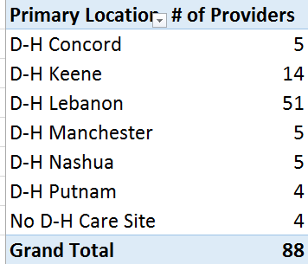
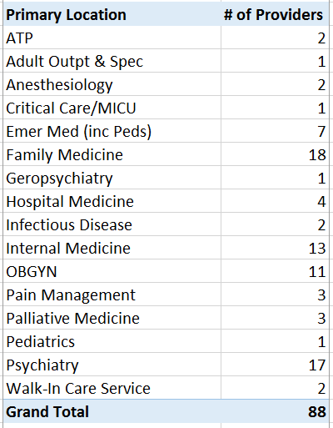
D-H Waivered Providers by Location & Service updated 2/28/19

Slide 28
Perinatal Addiction Initiatives

Slide 29
Integration
Notes:
Funded by NHCF, founded in 2018

Slide 30
Perinatal Addiction Initiatives
Moms in Recovery Program/IOP
iMAT-OB
CARPP Q&A Service
OB Purple Pod
PCORI
IDN funding to explore possible partnerships for residential treatment for women with children
Notes:
Target problem and population– perinatal and parenting women with SUD
Brief project description
Progress/status/data if available
Next steps & opportunities for other to engage /expand/replicate
Moms in Recovery Program/IOP (Julie)
One year anniversary of IOP (17 patients either completed or currently enrolled)
54 active total patients currently; ~175 over 5.5 years
Working on trying to fund positions through operations rather than external grants
Gathering data to track postpartum retention and outcomes of coordinated vs integrated care
iMAT-OB (Julie)
6 practices around NH all ready to accept patients
Implementation challenges- hiring of BHC, provider anxiety
CARPP Q&A Service (Julie)
Clinical and practice consultation for providers
Website, email, “warmline”
Over 100 inquiries
Other states inquiring about replicating
OB Purple Pod:
PGY2 resident clinic dedicated to the care of pregnant and postpartum women with SUDs
Team based, multidisciplinary care includes Behavioral health, Community Health worker, RN case management,
Residents obtain bup waiver training
Year 2 wrapping up in June
Specialty training has become a selling point during residency interviews
PCORI:
Data collection to start in June, 2019, IRB approved; > 24 sites across tristate region
Hiring to fill Data analyst and Research Nurse positions now
IDN funding to explore possible partnerships for residential treatment
Short term funding to describe model and identify possible funding sources
Multidisciplinary support- Ob/Peds/Psych
No long term residential treatment exists in the state for women with children north/west of Nashua
Alternatives include separation from children while mom goes to rehab, or refusal of necessary treatment
The optimal, replicable treatment model for this vulnerable population is not yet defined- rich area for research

Slide 31
Academic Mission
Psychiatry residency
Addiction fellowship
LICSW and BSW internships
Medical students
  While on the labor and delivery service, I helped care for a number of these patients, and I learned to manage their health in the acute setting. However, I did not learn anything about how to support these patients during and after their pregnancy…I got to witness the struggles these women face on a day to day basis and learned creative ways to assist in overcoming them. The clinic is clearly a safe place that these women rely on to obtain a variety of essential services.”
  “…I think every future physician should spend some time in an environment like the [Moms in Recovery] clinic, because if they did I think we would find that there is more empathy, connection and hope in the medicine we practice.”

Slide 32


Improving care for opioid-exposed newborns in Northern New England
Updates from Bonny Whalen, MD
3/4/19
Notes:
On Jan 22 & 23 we held our 2nd and 3rd ESC full day training conferences …

Slide 33
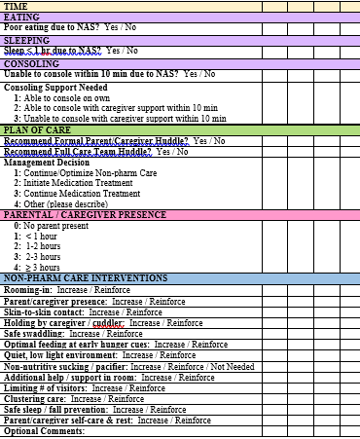
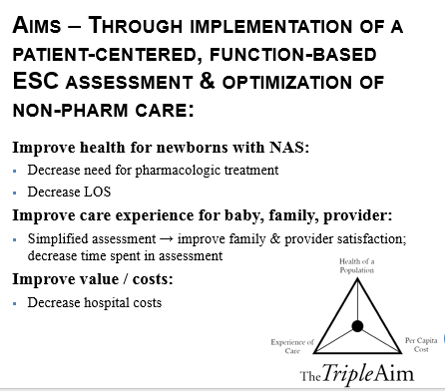
Development and Implementation of ESC Care Tool in Northern New England
Notes:
Thank you to Daisy Goodman, Julie Frew for slides

Slide 34
NNEPQIN ESC Updates
NH Charitable Foundation funding Jan – Dec 2019 to support ESC implementation in all 17 NH birth hospitals
  20% FTE - Project Lead, Bonny Whalen
  50% FTE – Project Manager, Farrah Deselle
  $10,000 – Quality / Data Specialist, Kate MacMillan
15 NH hospitals ESC-trained using standardized patients in DH Patient Safety Center (12 VT and 4 ME hospitals also trained)
2 remaining NH hospitals trained on site
Next 2 Sim Center trainings: March 25 and July 16

Slide 35
3rd Wed NNEPQIN Noon Webinars
Feb 20 NNEPQIN NAS Webinar Agenda
Regional data updates: Kate/Alan
ESC Project Update: Bonny
Concord Hospital’s ESC and non-pharm care journey: Erin Collins - confirmed
NH’s Plan of Safe Care template review – Erin Collins
Upcoming events/resources
March 20 NNEPQIN NAS Webinar Agenda
ESC Project Update: Farrah
Potential impact of opioids on neurodevelopment
  Katie Harris, Dartmouth College Research Intern
  Dr. Nina Sand-Loud, CHaD Developmental Pediatrician
  Dr. Alexa Craig, MMC Pediatric Neurologist
Upcoming events/resources

Slide 36
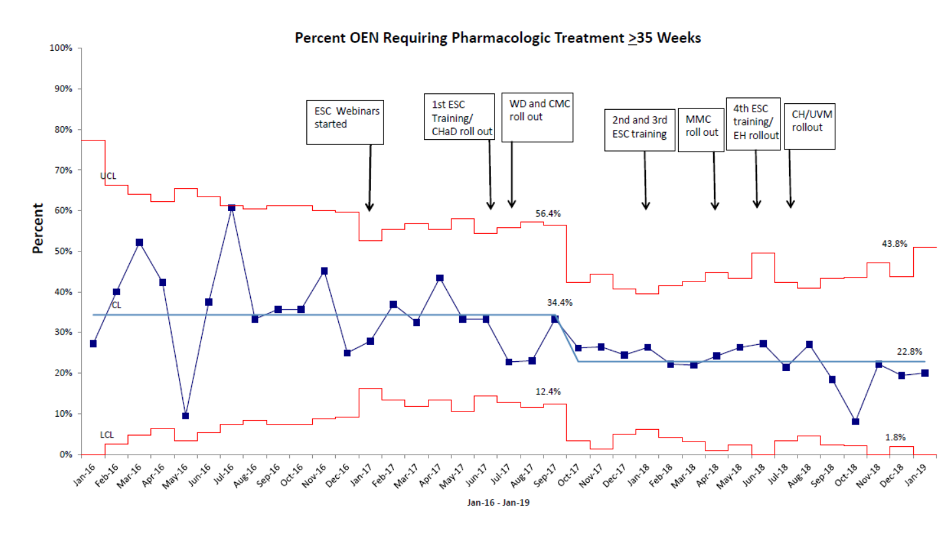

Slide 37
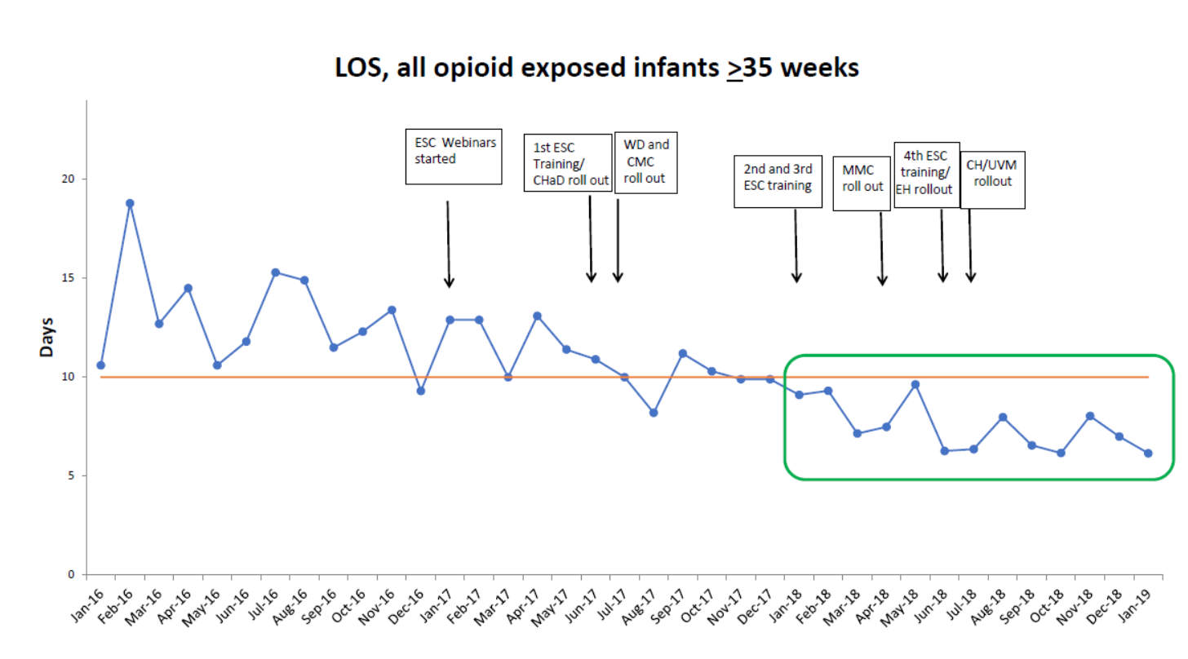

Slide 38
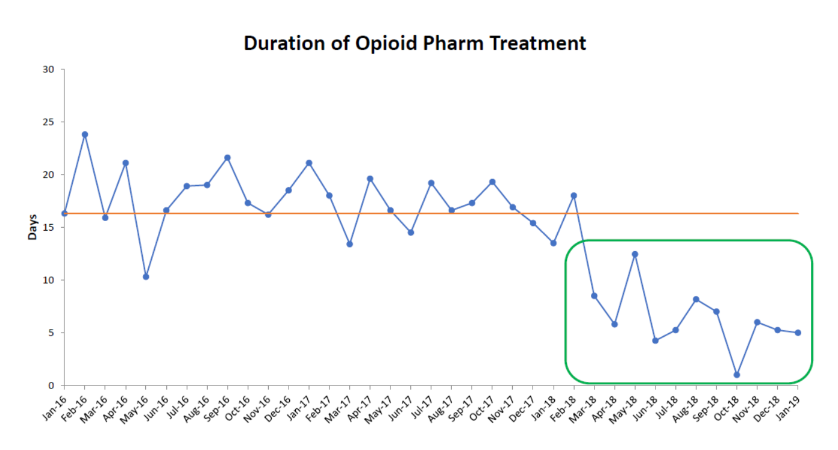

Slide 39
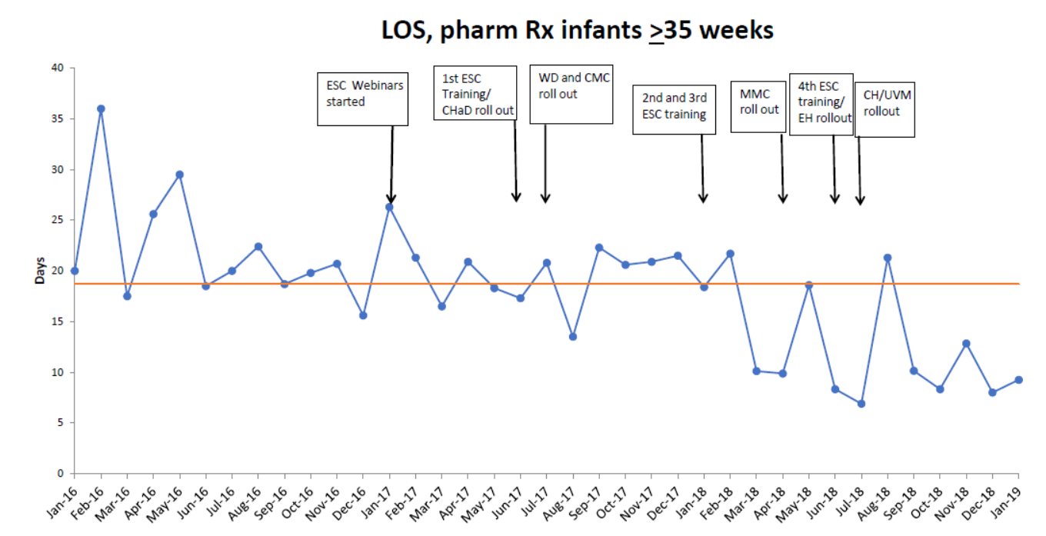

Slide 40
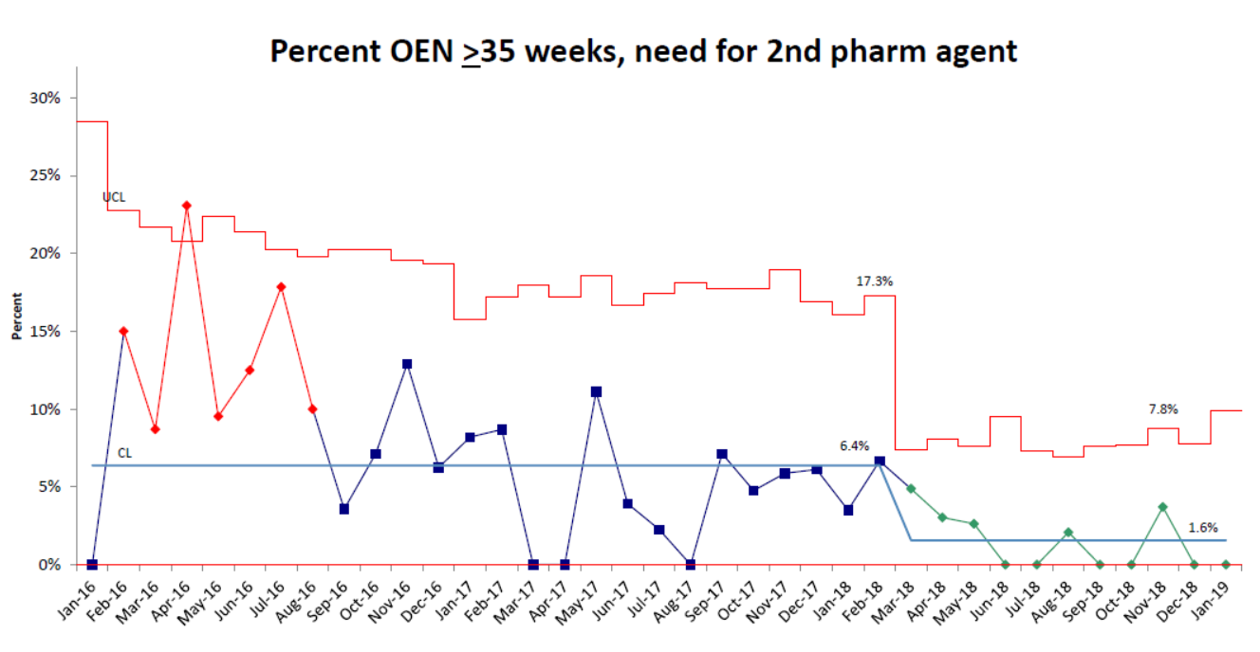

Slide 41
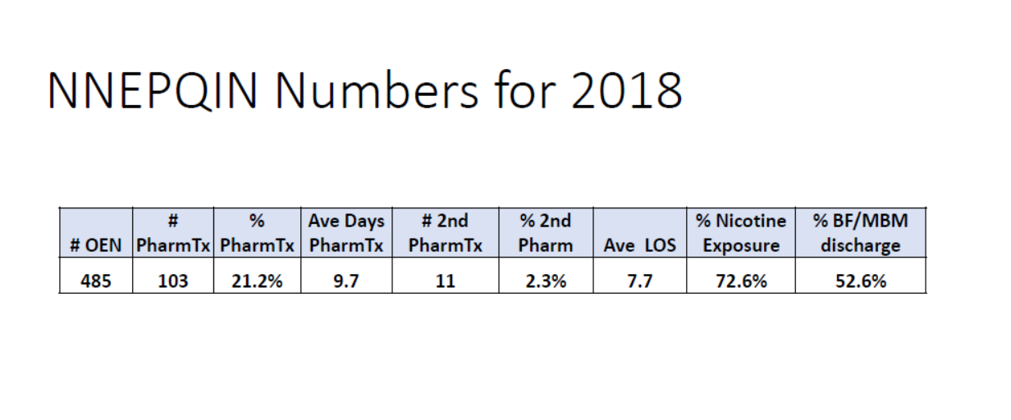

Slide 42
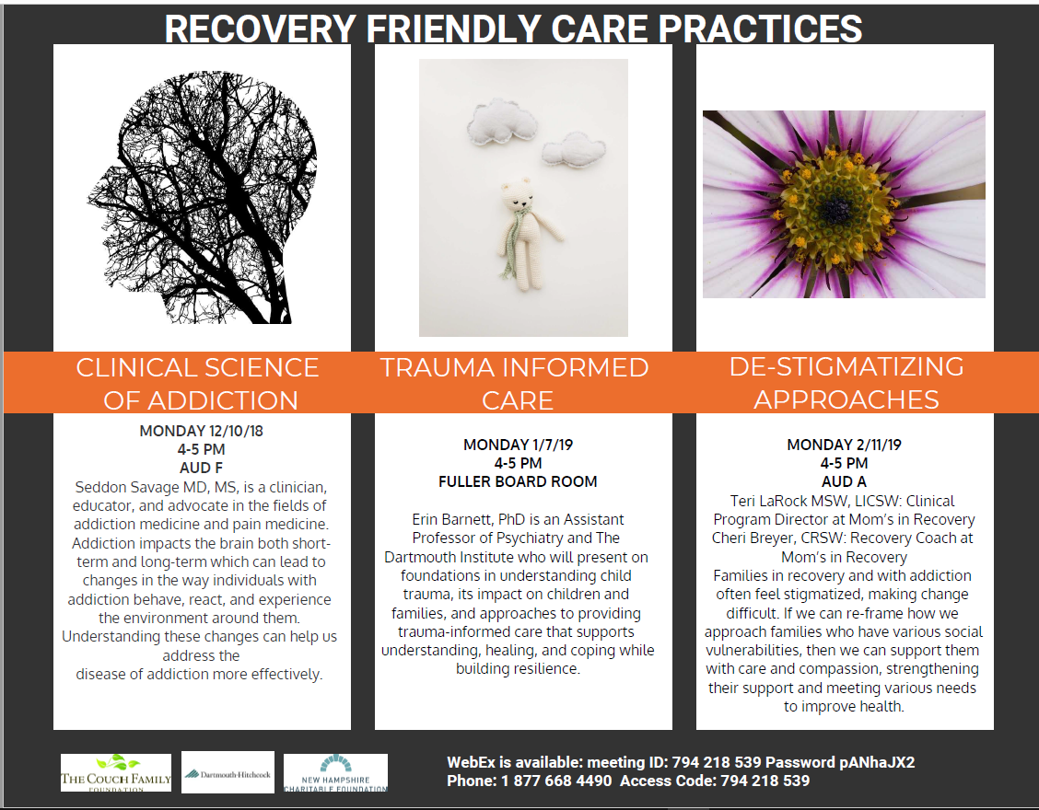

Slide 43
Next Steps
Developing ESC advisory panel
Developing monthly ESC “super user” group for challenging cases
Developing ESC guidebook for effective hospital implementation
Using feedback solicited from > 10 NAS experts and 18 NNEPQIN member hospitals to improve 3rd edition ESC Care Tool and training manual
Idea States Pediatric Clinical Trials Network (ISPCTN) ACT NOWS in final stages of NIH-funded protocol development to study ESC Care Tool vs usual care for opioid-exposed newborns in national cluster randomized step wedge trial

Slide 44

Jan 29, 2019
Concord, NH

Slide 45
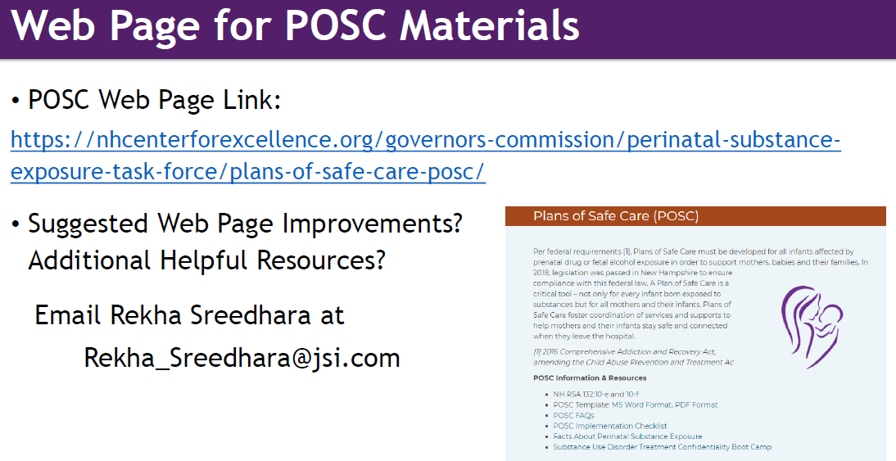

Slide 46
Integrated Care
Matthew S. Duncan, MD
Assistant Professor of Psychiatry
Clinical Director of Integrated Care
Dartmouth Hitchcock Medical Center
Notes:
Thank you
Paul for inviting me, to share the work of a large group of people over the past 10 years.
Dr. Torrey for his leadership in all of this work.
Sally Kraft in Population Health.
Large team of people I need to mention a few up front.
- Joanne Wagner, our BHC’s (Laura, Nancy Amanda – new cohort I’ll introduce later).
Jen Raymond – project manager
Charlie Brackett – IM Champion and KM representative.
Jules, Nisha, Gillian (Rick Farrell) – consultation in Primary Care – Gillian for eConsults.
Joe Bond – help on data
- you will see a whole range of people and a great deal of momentum over the past 2 ½ years
- our department joing DHMC/DH-H
State’s commitment to Integrated Care and responses to the Opioid Crisis.
This story of Integration is Really a story of the ever increasing realization and acceptance that mental health impacts everyone – either directly or through someone we care about and is essential to overall health
(Dr. Torrey quote: No Health without Mental Health)
And that for the past 100 years the care of people with MH and SUD has been marginalized, carved out, denied, fragmented, expensive and for many inaccessible.
However, We are now in a period where the forces of the public voice, legislation, payment models and delivery systems are motivated and incentivized to bring the care of the body and the mind together.
Not easy to create integrated care from systems that have evolved separately for so long.
Not fast, but the pace of change is increasing rapily – locally and nationally.

Slide 47
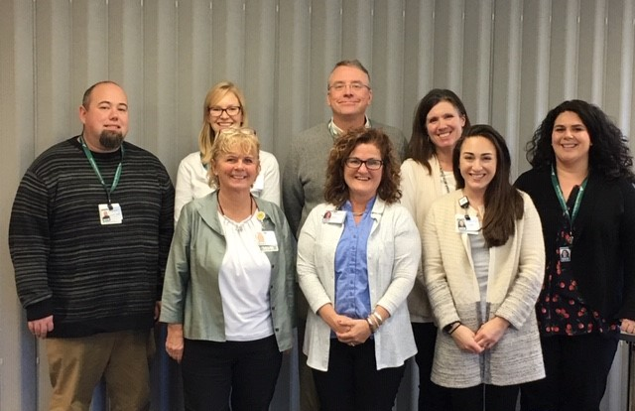
D-H Behavioral Health Clinician Team
Back row from left: Jacob Champney, Laura Blodgett, Eric Stanley, Ann Pitts, Alyson Lewis.
Front row fro left: Nancy Trottier, Joanne Fadale-Wagner, Amanda Totte.
Not present: Susan Pullen, Deb Hansen, Sara Baker.
Notes:
Support from DH-H and the state.
Hired 7 new BHC’s
Also want to mention
- Sue Pullen in peds Lebanon
Deb Hanson peds manhester
Sara baker – adult Nashua
Open positions:
Lebanon
Bedford
Nashua

Slide 48
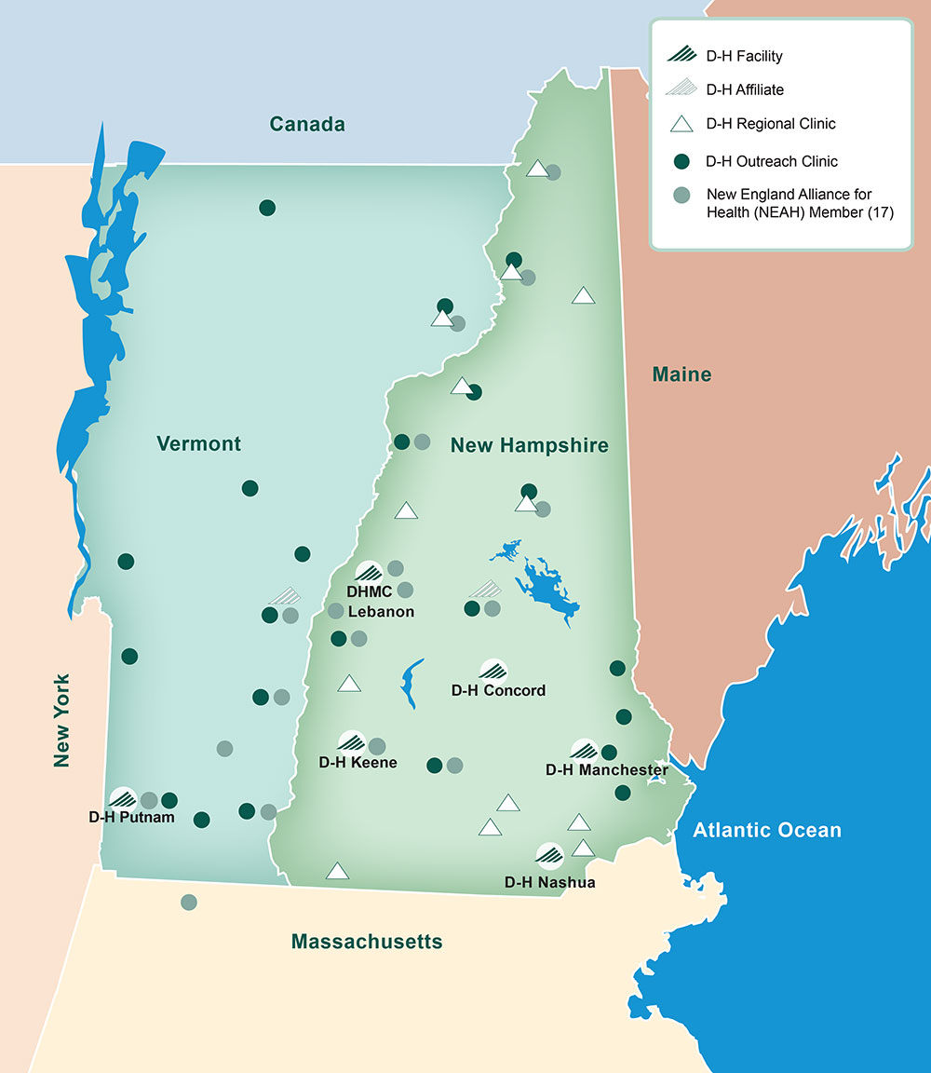

Lebanon
GIM – refining MAT, new CHW, CCSA has begun, 1st MDCT 3/11
Heater South – BHC posted, CCSA and MDCT ongoing, refining MAT
Heater North - BHC posted, screening for SDoH
Nashua
New BHC hired – Sara Baker
Concord
2 new BHC’s- Ann Pitts, Eric Shirley
3 new BHC’s -
Reorganizing MAT program with on-site APRN.
Manchester
MAT – partner with “Fusion”, community provider
Expanded to IM team 2/20
Adult- Alyson Lewis, Jacob Champney
Child- Deb Hansen

Slide 49
Rates of Screening and Positive Screens for Behavioral Health
Notes:
Been tracking our screening rates.
Light green all eligible patients to be screened.
Dark great – those completing the electronic screen.
As hi as 90%
National rate of 2-4%
Positives of thos who did the full.

Slide 50
Referral Volume and Registry Activity; NSH FP
48% of patients referred to BHC are in active care or have completed an episode of care
Notes:
Those positive referred to BHC
50%
And of those 50% engaged with BHC or complete an episode of care which averages 3 months
- combination of phone and in office outreach.

Slide 51
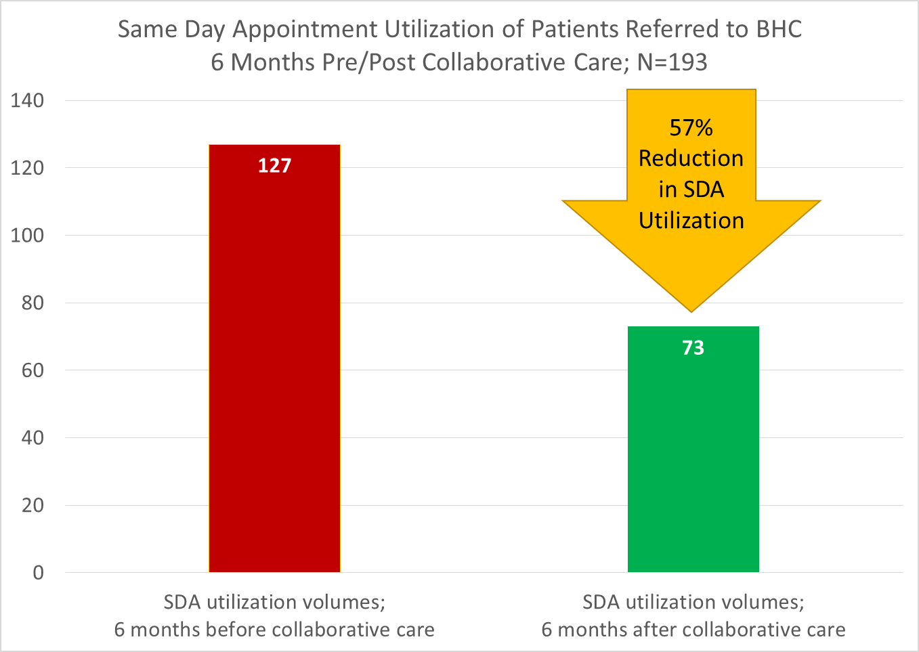
Same Day Appointment Utilization Decreased
43%
Notes:
One of the goals of BHI is to not only to provide a resource to primary care to address the breadth of these clinical issues but also to demonstrate some sort of financial value to the senior leaders.
For patients enrolled in Collaborative Care – the model described earlier
One of these measures is to open up access to the department. This shows a decrease of 57% of same day utilization of SDA and SDA ext appointments in FP

Slide 52

Collaborative Care Registry Volume
Current total = 815 patients
Nashua Pilot
BHC hiring wave
Notes:
Since this expansion – hiring wave
Number of patients we are identifying and systematically tracking is increasing rapidly
1/3 of patients being identified, referred to BHC and systematically tracked – since Dec 2018 (3 months ago)

Slide 53
Clinic Level Metrics
BHC Level Metrics
Notes:
Joe has helped us build this dashboard –
Monthly be able to see our screening rates, positive screens, rates of referral to BHC’s.
If patients are entered on the registry and making contact in that first 30 days.
The proportion of cases being reviewed with the consulting psychiatrist.
Very Exciting
============================
Top Left: Blue portion is the total number of patients eligible for screenings. Green is the total number who completed some form of BH screening.
Top Middle: the blue bars are the number of patients who completed some form of BH screening (same number as green mountain on top left). Green bars are those who scored positive on a full screen (not the 2 question screeners, but the full ones).
Top Right: Total number of patients referred to BHC monthly
Bottom Left: Meant to track patients through the process from referral to registry to initial contact with BHC to in-office appointment with BHC to discussion with consulting psychiatrist
Bottom Right: Meant to give a mile-high view of the percent of patients each year that are in each step of the process. “Dropped-out” refers to those patients who had some contact with BHC but did not complete the program and are not currently active. “Lost to Follow-Up” refer to those patients who were not or could not be contacted by BHC for initial contact.

Slide 54
Quality Metrics
Special Cause Variation
Points above the UCL (represent high performance)
Points below the LCL (represent low performance)
National Screening rates for depression in primary care settings was reported to be 4.2% nationally between 2012 and 2013¹. So, DHMC, even at the lowest point, is well above the national average…and we can still do better.
Akincigil, A., & Matthews, E. B. (2017). National rates and patterns of depression screening in primary care: results from 2012 and 2013. Psychiatric services, 68(7), 660-666
Notes:
Joe’s also helping us track trends in our sreening rates to make sure our systems are stable.
P chart shows normal variation and months where we have outlying data – helping us maintain stable systems over time.
======================================
Here you will also see the Nashua screening rates – despite variation – averages over 50% being screened.
National average in primary care – green line – 4.2%
=========================================
National Screening rates for depression in primary care settings was reported to be 4.2% nationally between 2012 and 2013¹.
1. Akincigil, A., & Matthews, E. B. (2017). National rates and patterns of depression screening in primary care: results from 2012 and 2013. Psychiatric services, 68(7), 660-666.

Slide 55
Community & Pediatric Care Collaboration
Population and Community Health Improvement
Holly A. Gaspar, CCLS, CTRS, Med

Slide 56
Problem
Children nationally are exposed to parental substance misuse: 8.7 million 2009-2014
Co-occurring adverse events are higher with families who use substances
In New Hampshire:
20% of children ages 17yrs and younger have had 2+ Adverse Childhood Events (ACE)
31% of children ages 0-5yrs have 1+ ACE
Children who are exposed to adverse events in childhood have a higher likelihood of misusing substances in adulthood
Early childhood is a critical time for healthy brain development

Slide 57
Strong Families, Strong Starts

Slide 58
Community Partner Process Improvement

Slide 59
Clinic Process Improvement Results

Slide 60
What We Have Learned & Next Steps
Need for staff education & process improvement related to high risk populations to improve care
Need for engaging early in supports
Referrals don’t = engagement (learn what makes a family engage)
Create opportunities for this
Strength based approaches to care with families is important
Collaboration between programs to enhance communication
Increase efforts in OBGYN
Innovative strategies for complex environments and complex needs
Opportunity for cross system collaborations

Slide 61
Initiatives Palliative Medicine and Oncology
Kathleen Broglio, DNP, ANP-BC, ACHPN, CPE, FPCN
Nurse Practitioner, Section of Palliative Medicine
Assistant Professor of Medicine, Geisel School of Medicine at Dartmouth
Scholar, Dartmouth Collaboratory of Implementation Sciences
Kathleen.broglio@hitchcock.org
3-2019

Slide 62
Palliative Medicine
Initiation of opioid management guidelines October 2016
  Utilized by all providers in palliative care clinic for any patient prescribed opioids
  Engaging partners in the Southern New Hampshire
Medication Assisted Treatment for those with serious illness/comorbid Opioid Use Disorder – initiated July 2017
  Three waivered providers
  Collaborate with inpatient teams for patients with serious illness
Next steps
  Opioid Risk Screening by Palliative Care providers in inpatient setting consultations with appropriate referrals to treatment

Slide 63
Opioid Risk Screening in Oncology
Feasibility pilot for screening for opioid use disorder in thoracic/head and neck clinics
  Pilot of opioid risk screening using Opioid Risk Tool in thoracic and head/neck clinic (n = 40); 30% patients screened moderate to high risk
Enduring education (opioid resources)
  Screening for opioid risk using ORT
Next steps
  NCCC point prevalence study to establish baseline data of risks for opioid misuse and evaluate need for center-wide screening as standard of care (grant application pending)

Slide 64
Screening for Substance Use Disorder in Oncology
Survey oncology clinician to assess current screening for alcohol and substance use
NCCC Grand Rounds October 23, 2018 based on survey results
  Enduring education on screening/referral (opioid education resources)
Post-education survey
Meeting with infusion center leadership (4/2019) to provide education and resources to infusion nursing

Slide 65
Thank you
Contact Kathleen Broglio – kathleen.broglio@hitchcock.org

Slide 66
Project COMPEL
Opioid Rx
Take 1 tab every 4 hours PRN
(Changing Opioid Medication Paradigms for Effective Living)
Mobile Sign In Code:

Slide 67
Agenda
Pain Management Overview
Project “COMPEL”
LDN as Opioid Alternative
Next Steps
Questions

Slide 68
Drivers for Paradigm Change
Evidence based medicine: Opioids have limited indications in the domain of chronic pain management
We considered Risks, Benefits, and Alternatives for each patient individually.
Risks and side effects frequently exceed purported benefits
Escalated doses lead to escalating pain: opioid-induced hyperalgesia
New research suggests no greater efficacy than traditional anti-inflammatory medications
Notes:
This is what we knew.

Slide 69
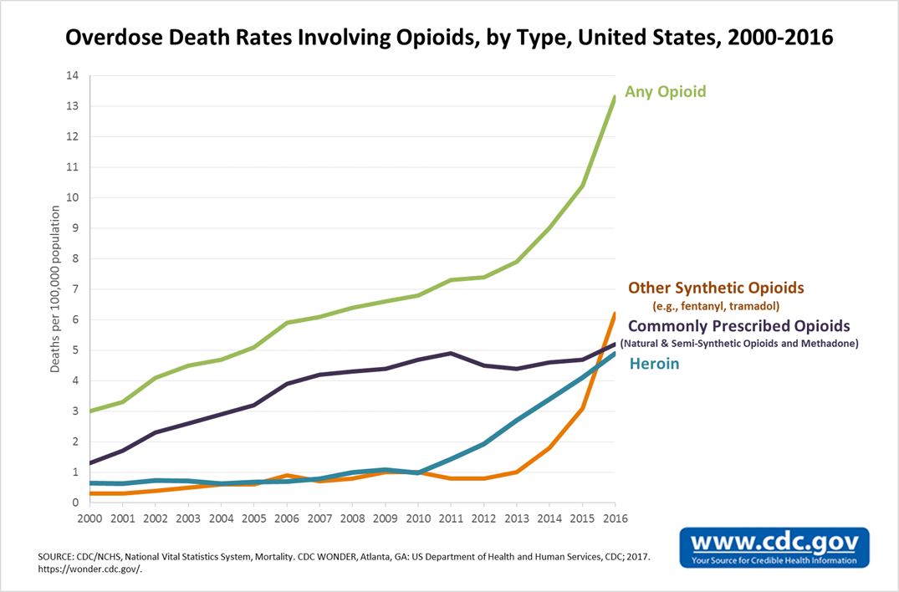
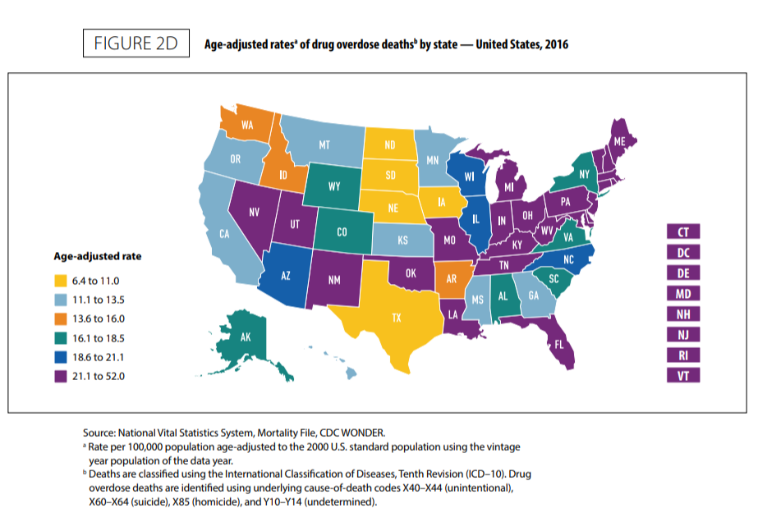
Opioid Statistics
2016 NH Opioid Statistics
  NH has 2nd highest opioid overdose rate in the country
  437 opioid-related deaths
  Overdose rate tripled between 2013 and 2016
Notes:
And this is what we were seeing. New Hampshire had the 2nd highest opioid overdose rate in the country with 437 deaths in 2016.
While our primary driver was the lack of efficacy opioids seemed to have for our patients, the national opioid crisis was a secondary driver for us to make this change.

Slide 70
Questioning our Principles
Do we believe these medications constitute the best therapy to help patients reach their functional goals and pain relief?
Are there more effective, evidence-based options for our patients?
Would changing care plans to no longer include opioids be considered compassionate care?
Are we treating the root cause? Or just the symptom?
Are we contributing to the “Opioid Crisis” with our current practice?
Notes:
As a section we had to ask ourselves…
Do we believe these medications are the best therapy that we can offer?
Are there more effective, safer, options?
Would our care still be considered compassionate even if we changed care plans to no longer include opioids?
Lastly, the most significant question we asked was whether or not our practice was contributing to the Opioid Crisis.

Slide 71
Project Structure
Business Process Re-design (BPR)
Create a vision, values, and objectives
Describe the current environment
Brainstorm improvement ideas
Pilot the change
Evaluate the change
Implement the change
Notes:
This is what we did.

Slide 72
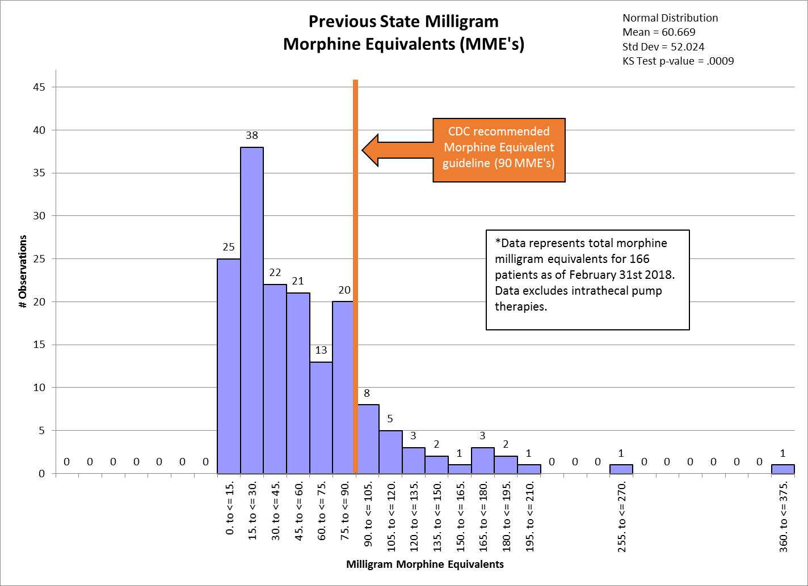
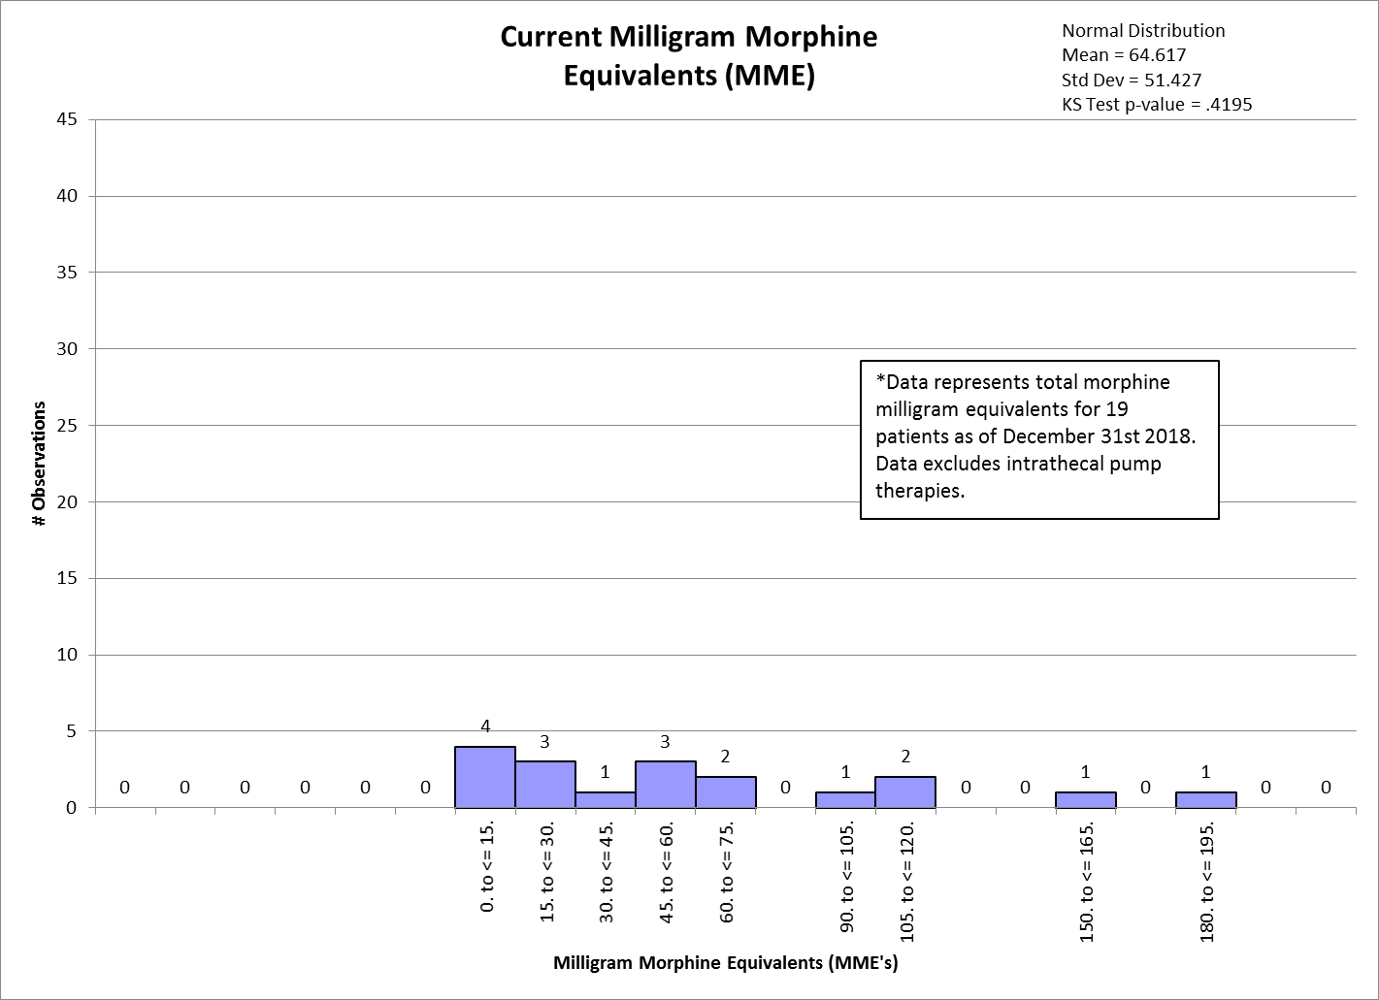
Morphine mg Equivalents (MME’s)
Notes:
When we compare our morphine equivalents from before and after, we still have a spread of milligram morphine equivalents, but far less overall prescriptions.

Slide 73
Community Impact
Removed 14,475 opioid pills from the community on a monthly basis.
Opioid Rx
Take 1 tab every 4 hours PRN
Do not take if pregnant
Check wit h
Notes:
This reduction in prescriptions translates to over 14,000 pills entering our community on a monthly basis.

Slide 74
Notes:
And we were able to make that decrease in opioid pills while also maintaining our patients ability to control their pain. The blue boxes on this graph indicate pain scores for the middle 50% of our patients, which have remained relatively unchanged.
This suggests that either opioids didn’t help our patients, or that the alternatives we’ve been providing work just as well.

Slide 75
Project Structure
Business Process Re-design (BPR)
Create a vision, values, and objectives
Describe the current environment
Brainstorm improvement ideas
Pilot the change
Evaluate the change
Refine the change
…and Considering Alternatives
Notes:
This is how we make it better.

Slide 76
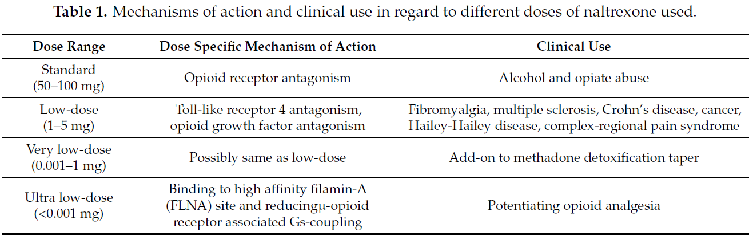
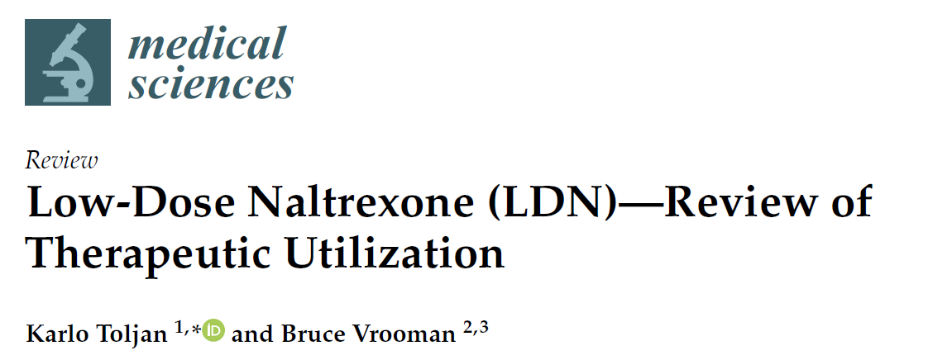
Low Dose Naltrexone (LDN)
Review
  2018 Publication
Notes:
LDN is a compounded medication that works as an opioid antagonist that helps to increase responsiveness to our own endorphins (ENDOgenous mORPHINe).

Slide 77
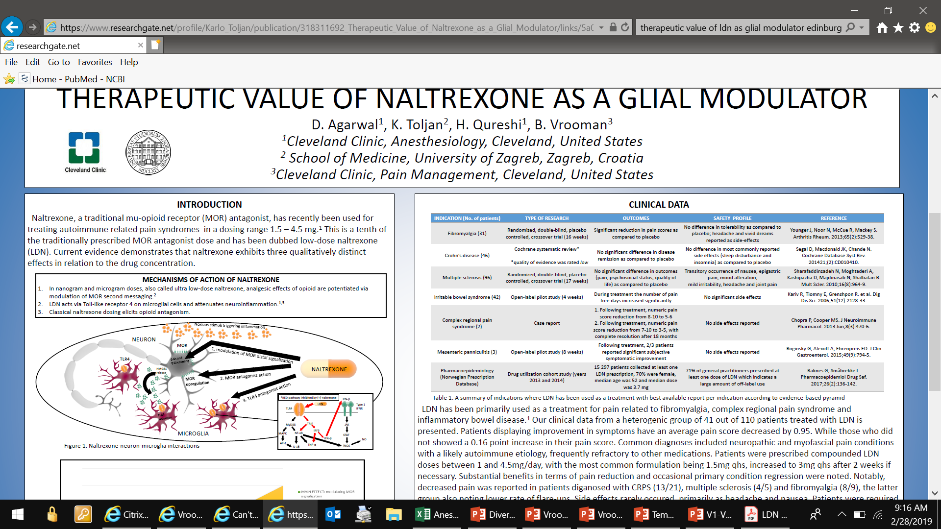
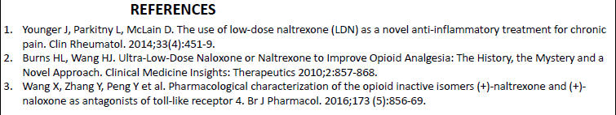
3 qualitatively distinct effects in relation to the drug concentration:
Notes:
LDN also helps to decrease the activation of microglia in our nervous system.

Slide 78
Vermont Legislature
Difficulty in obtaining insurance approval for compounded medications but NOT for opioids despite lack of evidence in chronic pain management
Testified to Committees
  Senate Health and Welfare
  House Human Services
Worked with VT Medicaid Subsequently
Notes:
The Vermont Legislature was supportive of our work to explore options for improving access to care for patients.

Slide 79
Vermont Medicaid Pilot
Free 2 month trial of LDN for Medicaid Patients
Developed novel dosing regimen
Followed all patients on LDN
Phone or OV follow-up
Notes:
We have worked with the team at Vermont Medicare to pilot our work on LDN as an opioid alternative.

Slide 80
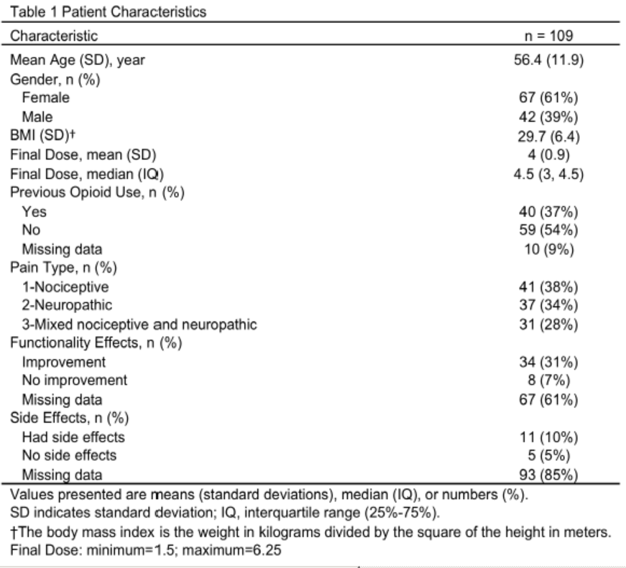
Vermont Medicaid Pilot
LDN as an Opioid Alternative
Evaluated first 109 Patients
Looked at Nociceptive, Neuropathic, and Mixed Pain States
Considered prior opioid use (Y/N)
Notes:
This has been a small pilot with encouraging results.

Slide 81
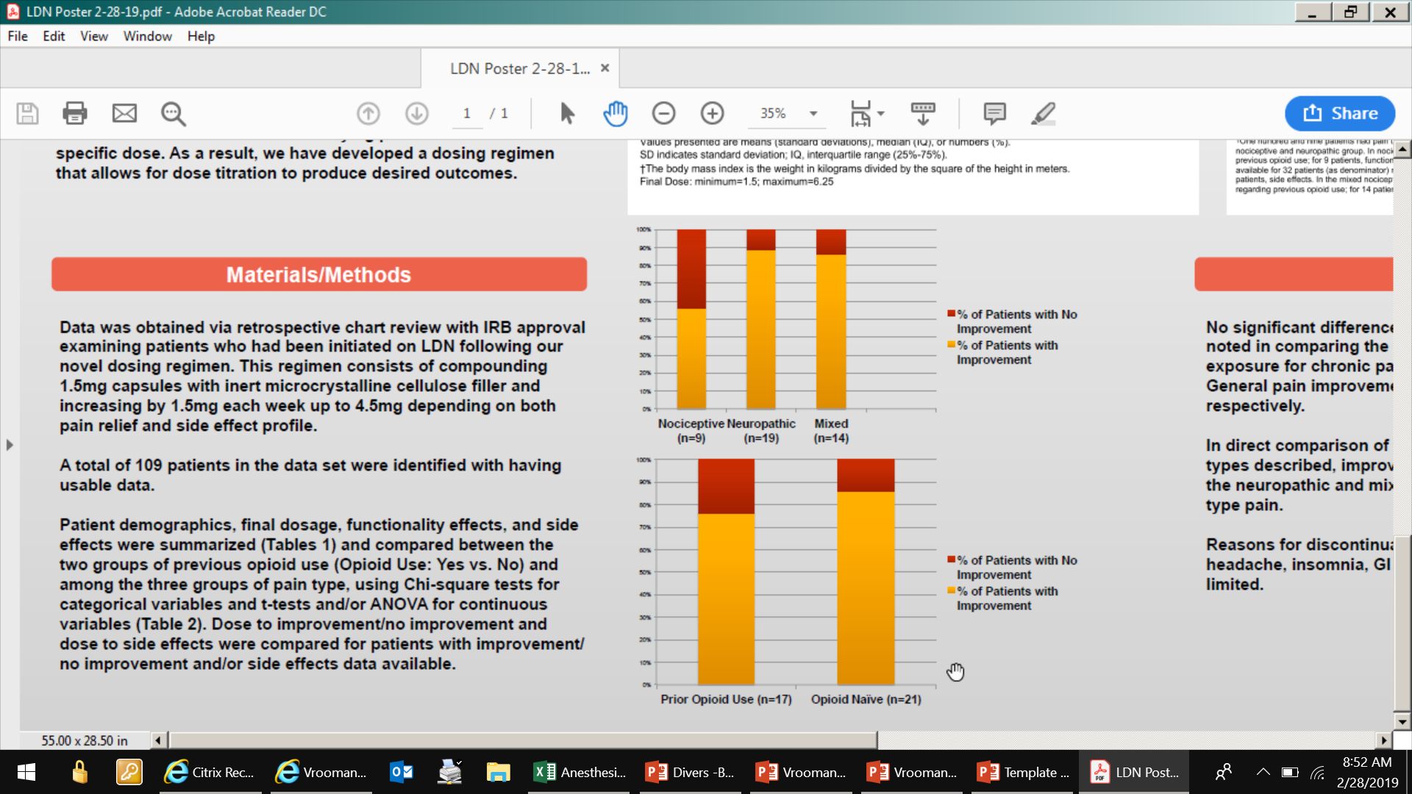
Vermont Medicaid Pilot
Pain State? Prior Opioid Use?
Notes:
Patients with neuropathic and mixed pain states have shown improvement. Those with prior opioid use and those who were opioid naïve have had similar results.

Slide 82
Next Steps
Continue to expand LDN research
Continue to evaluate new therapies for non-opioid pain management
  Only site in New England selected for basiverterbral nerve radiofrequency ablation study
  Ziconotide intrathecal therapy
  Abdominal pain procedures
  Head & neck procedures
  Mindfulness
Further collaboration around patients (Spine, Behavioral Health, Social Work, etc.)
Recruit a Pain Psychologist embedded in Pain Management Section
Notes:
We have a number of next steps we aim to reach

Slide 83
Our team did the work!
Colleen Olson, APRN
David Dent, DO
Jan Gellis, MD
Bert Fichman, MD
Kim Youngren, MD
Guannan Ge, MD
Abdullah Kandil, MD (Fellow)
Jude Divers, MD (Fellow)
Cam Cunningham, MD (Fellow)
Graham Wagner, MD (Fellow)
Brynna Riley, Sr. Scheduler
Haley Johnson, Sr. Scheduler
Melissa Thorne, Sr. Scheduler
Erin Marcotte, Sr. Scheduler
Sara Dennis, RN
Judy Gadway, RN
Janet Vielguth, RN
Annette Harding, RN
Linda Johnson, LPN
Allie Hazelton, LNA
Divina Carrier, LNA
Emily Crouse, APRN
Deb Scribner- Director
Kermit Hummel, PA
Sloane Yu, MD (Former Fellow)
Lauren Del Prato, DO (Former Fellow)
Liz Ossen, MSW (Spine Center)
Research Team:
  R. Jake Measom, MD
  Jessica Zhang, MD
  Amanda Chen
Notes:
We have an excellent team driven to help make effective change.

Slide 84
SUMHI Culture Change & Education
Core activities
SUMHI Website
Training & education
Culture change
Team
Seddon Savage
Ariel Pike
Laura Fineberg
*Charlie Brackett

Slide 85

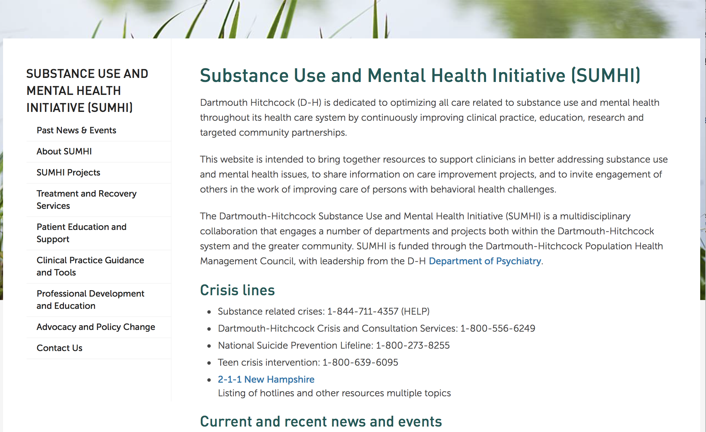
https://med.dartmouth-hitchcock.org/sumhi.html
Please send Ariel Pike any info education/training to post on website for sharing.

Slide 86
SUMHI Culture Change & Education
Education & Training Support
Technical assistance to developing education, trainings
    Review and suggestions for proposed trainings
    Identification of DH and outside speakers
    Provide presentations & trainings
Identify or develop training support materials as needed
Post or link to archived trainings as possible, eg
    DSRIP track at December Behavioral Health conference
    Trilogy of Recovery Friendly Pediatric practices
    Opioid Updates
    Others

Slide 87
Culture Change
Survey DHH Opioid Change Champions, December, 2018 (10 sites)
1. Ways BH stigma or discrimination manifest healthcare & how they impact patients or staff?
Staff…
“Feel discomfort with treatment of patients with SUDs”
“Largely do not understand addiction”
“Lack treatment resources”
“Are not comfortable talking with these uniquely challenging patients”
“Assume pain is drug seeking”
“Pre-judge patients based on diagnosis”
“Feel traumatized by demanding patients”
“Experience frustration: express with eye rolling, tonal anger, hurtful comments”
Patients…
“Feel judged and ashamed” “pre-judgement affects patient care”
“Have bad patient experiences [due to staff speaking negatively]”
“Resist seeking needed care as a result of the way they were treated”
“…on buprenorphine complain they are treated like drug addicts and second class citizens”
“…on opioids are perceived as drug seekers”
“Can get frustrated and yell at staff”
2. “This is not specific to our site. It is pervasive.” (8 of 8)

Slide 88
Inventory Dartmouth Hitchcock Culture Change Activities
1. Education, Knowledge & Understanding
(Neurobiology, Chronic Disease Model, Stigma)
2. Staff Empowerment
(Tools, Resources & Care Transformation)
Academic lectures
  Grand rounds (Psych, Surgery, Medicine, other)
  Section meetings - IM, Hospitalist, others
NAMI LNA/MA MH stigma awareness trainings
  DHMC December; Manchester- February
In-service trainings supporting practice change
  Trauma, Stigma, Science of Addiction – Pedi, ED
  Cheshire Medical Center- stigma training all staff
Online Opioid & SUD CEU activities, DH Office of CE
Stigma Think Tanks – Anna Adachi Mejia
OATC – DHMC launch, spread to other sites
MAT implementation & cultural transformation -APD
CARPP – DHMC launch, now multiple sites
SBIRT initiatives – DHMC Pedi, BH integration
Recovery Friendly Practices
BH Integration – Nashua launch, with spread
DSRIP networks
3. Contact: Familiarity, Recognition, Personalization
4. Language & Communication
Recovery Coach clinical engagement
  ED, Inpatient
Persons with lived experience presenting
99 Faces Exhibit & associated-launch April
  Book readings
  Film showings
REACT campaign, John Broderick outreach
Christine Spring’s bookmark/pin project
Opportunities
  Clear statement & communication of DHH non-discrimination policy
  Set person centered, non-discriminatory language expectations
    Words Matter document, others

Slide 89
4. Efforts to combat Behavioral Health Stigma at your D-HH site?
NASHUA
BH integration pilot
  Routine screening MH & SUD
  Embedded MH services
Engaging PCPs in MAT
MANCHESTER
Classes on Stigma at the nurse and MA level.
Needs to get to providers
APD
Intensive MAT & SUD Tx Implementation process
  All PCP staff education
  Ongoing mentorship
New broader trainings
CONCORD
Talks from expert groups to help staff
MAT implementation
D-HH SYSTEM
(Responding Sites)
MT ASCUTNEY
Education & awareness training
CHESHIRE
Moms in Recovery
PC: BH consult expansion & MAT grant from FHC
Established as Keene HUB
Defined principles for BH care improvement
MFS reverse integration project
Stigma identified as key barrier > active trainings 2019
DHMC
Academic grand rounds
IM, Hospitalist, FP, ED Pedi section/in service trainings
Opioid Addiction Treatment Collaborative
Community Group Practices
Two embedded BH specialists
Two supervisors with week long OUD training.
  Targeting staff trainings

Slide 90
SUMHI Culture Change Campaign
Bringing together efforts at change across the system
  Supporting work aimed at Culture Change
  Principles/policies group considering
    Vision for care of persons with mental health and/or SUDs
    Affirmation regarding staff-patient interactions (BH versus all diverse)
    Considering promotion/requirements for basic relevant training
    Next meeting March 12th
~Drafts in Progress~
Vision: We envision a healthcare system where mental health & substance use disorders are treated with the same urgency, respect, and seriousness of purpose as other important illnesses and where stigma and discrimination do not occur.
Affirmation: We will establish authentic partnerships with our patients and communities that honor the humanity, diversity and dignity of all and in which we address each person with respect and compassion at all times and learn from each encounter.

Slide 91
SUMHI Culture Change & Education
Please share resources, questions, needs, thoughts re:
SUMHI Website * Training & Education * Culture Change
seddon.savage@dartmouth.edu
Ariel.A.Pike@hitchcock.org
Laura.J.Fineberg@hitchcock.org

Slide 92
Other DHH SUD Harm Reduction Initiatives
Post-surgical prescribing – Richard Barth & colleagues
Naloxone distribution- DHH community sites
Syringe service program, Claremont – Geisel Medical Students & HIV programs
Drug take back & destructions programs – DHH pharmacies and Deterra initiatives
Others?

Slide 93
Reminder:
Please send your email address to Ariel Pike at ariel.a.pike@hitchcock.org if you are not attending in person.

Slide 94
Discussion Points
Are there other clinical care or harm reduction initiatives addressing these issues?
Are there challenges that we are not addressing?
How can we expand what’s working?

