Slide 1

Caring for Babies Exposed to Methadone or Buprenorphine During Pregnancy
Bonny Whalen, MD
Medical Director / Newborn Pediatrician
CHaD/DHMC Newborn Nursery

Slide 2
Your Baby and Subutex or Methadone
What have you heard?
What are you worried about?

Slide 3

Neonatal Abstinence Syndrome (NAS)
Caused by withdrawal from opiates / opioids
Problems with over-function of the:
  Central Nervous System (CNS)
    Brain, nerves, muscles
  Autonomic Nervous System
    Breathing, blood vessels, metabolism
  GI tract /intestines
    Feeding, vomiting, stooling

Slide 4

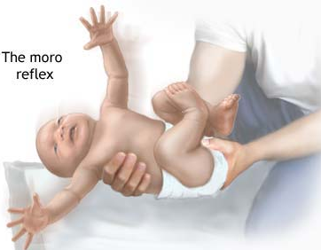
PROBLEMS WITH THE CENTRAL NERVOUS SYSTEM
Increased crying / problems consoling
Problems sleeping
Overactive startle reflex
Tremors / jitteriness
Increased muscle tone
Myoclonic jerks
Seizures
Notes:
Abrupt “state” changes

Slide 5

PROBLEMS WITH THE AUTONOMIC NERVOUS SYSTEM
Fever
Sweating
Yawning
Mottling
Nasal stuffiness
Sneezing
Problems breathing / Increased work of breathing
  Nasal flaring
  Tachypnea
  Retractions (pulling in between ribs)

Slide 6


PROBLEMS WITH THE GI TRACT
Excessive sucking
Poor feeding
Spitting up / vomiting
Loose stools
Watery stools

Slide 7
NAS: What to Expect
~ ¾ (or more) infants will develop some signs of NAS
Symptoms start on 2nd day & most often peak on 3rd to 4th day of life
Symptoms may be worse or seen earlier if mother is:
  Smoking cigarettes, on some medications for depression or anxiety, or using other substances
Baby will need to be monitored for at least 4 days, and longer if still having NAS symptoms and hasn’t “peaked” yet

Slide 8
NAS: What to Expect
If treatment with medicine is required, length of time for treatment and observation off of treatment can vary from one to several weeks
No relationship between dose of mother’s medicine and how severe NAS is or how long treatment is needed for baby
It is best to not try to wean medicine during pregnancy due to risk of relapse for mother, and risk of withdrawal for the fetus

Slide 9
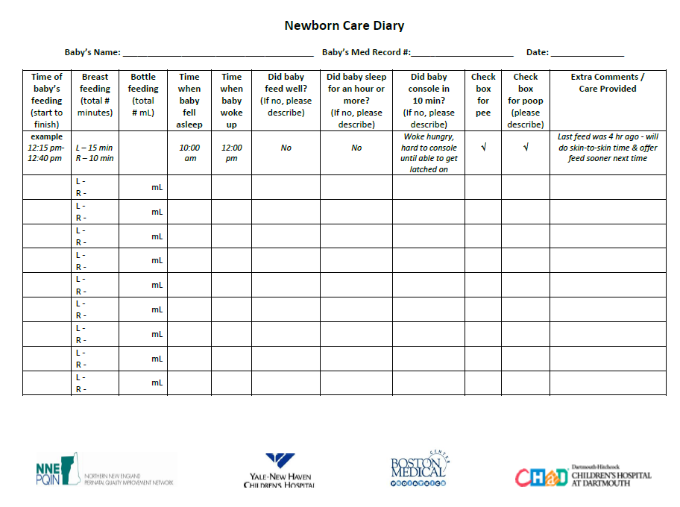

NAS Assessments
Help baby calm first before assessment
  Put baby skin-to-skin before assessment
  Feed baby first, then call RN to come in and do assessment
  Have baby on you doing skin-to-skin during assessment if possible
Keep track of baby’s eating, sleeping, and consoling (comforting) using the Newborn Care Diary
Review Diary with your baby’s providers

Slide 10

Helping Your Baby with NAS
You are your baby’s first and most important treatment
Most babies can be cared for with your Tender Loving Care (TLC) alone
If your baby has very intense NAS symptoms, she may need medicine (like morphine) to help her
Notes:
You are your baby’s first and most important treatment
You are an important part of your newborn’s care team

Slide 11
Deciding When Medicine is Needed
Baby may need treatment:
Problems Eating, Sleeping, or Consoling (Comforting)
Having hard time breathing
Vomiting and losing too much weight
Baby needs treatment:
Apnea or seizures (very unlikely)
Unable to eat, sleep for at least one hour, or console despite optimal supportive (non-pharm) care measures

Slide 12

ROOMING-IN
Keep your baby with you in your room at all times
  You can respond to your baby’s feeding and stress cues earlier
  You can keep your room calmer / quieter than out in the Nursery
  Helps you feel more comfortable caring for your baby when you go home
If you need to go get your medicine or leave your baby’s room, have a family member or friend take care of your baby in your room
If you need extra help, we have a Cuddler Program that can help provide extra support!
Notes:
Rooming-in:
Decreases need for NAS treatment with medicine
Decreases duration of treatment with medicine
Decreases length of stay

Slide 13
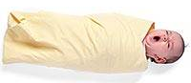
Help comfort / calm your baby
Feed your baby at early feeding cues, until content
Hold your baby close to you in skin-to-skin contact (when you are not sleepy)
Breastfeed your baby
Talk or sing to your baby
Swaddle your baby in a thin blanket (keep top of blanket away from face)
Gently sway or jiggle your baby (with slow up & down movements)
Use a shooshing noise
Have your baby suck on a finger or pacifier (when not hungry)
Notes:
Teach parents ways to keep babies organized and calm

Slide 14

SUPPORTIVE CARE FOR NEWBORNS
Provide undisturbed periods of sleep / rest
  “Cluster care”
Keep the room very calm
  Low lights
  Quiet room
  Limit visitors / # caregivers
  Avoid “excessive handling” of baby
Introduce increased noise and touch when baby is able to tolerate
  Infant touch / massage
Notes:
Provide calm, quiet environment

Slide 15
BREASTFEEDING AND YOUR MEDICATIONS
Breastfed infants may experience less severe NAS symptoms
Breastfeeding is one of the best things you can do for your baby. It helps your baby fight off infections and helps with his / her long-term health. It also helps you!
Methadone and buprenorphine are safe in breastfeeding
Do not use illegal substances (including marijuana) or medications not prescribed to you during breastfeeding

Slide 16
TRICKS AND TIPS FOR BREASTFEEDING
Breastfeed in a calm environment
Breastfeed baby when hungry, till content
Do lots of skin-to-skin
Breastfeed in “C-hold” (football, cross cradle positions)
Use hand expression to help baby get milk
If baby having problems with withdrawal (NAS), have baby suck on your finger first to organize suck
Nurses and Lactation Consultants will help if having problems

Slide 17
Ways to help your baby do best!
Attend all of your prenatal visits
Take your medication as prescribed
Stop using nicotine
Do not use marijuana or other drugs
Breastfeed your baby
Comfort your baby with skin-to-skin contact
Stay with your baby in a calm, quiet environment
If you follow these steps, your baby has a less than 10% chance of having NAS symptoms that need medicine

Slide 18
In-hospital Drug Testing
Mother: Urine testing
Baby: Umbilical cord testing
  Urine testing if mother’s urine not obtained on admission
  Meconium testing if mother given medication during labor (example: morphine) that may have been taken illegally during pregnancy

Slide 19
IN-HOSPITAL CARE COORDINATION
Care management team = Social worker and case manager
  Performs initial assessment of mother and baby
  Reviews risk for postpartum depression and stress & helps identify supports and ways to cope
  Performs mandated report to DCF/DCYF per state / federal requirements
  Helps develop “Safe Plan of Care” & shares with DCF/DCYF before discharge
  Assists in identifying and arranging supports for home:
    VNA (Visiting Nurse): Follow-up in home 1-2 days after discharge
    Early Intervention (EI) referral for helping with baby’s development
    Good Beginnings volunteer program
    Breast pump assistance
    Can help identify Primary Care Physician (PCP), if needed

Slide 20

BABY IS READY FOR DISCHARGE:
Stable vital signs
No breathing problems
No significant problems with withdrawal (NAS) after 4 - 5 day observation period
  Eating, Sleeping, Consoling well with normal weight loss
Parents comfortable and confident in caring for baby
No concerns for safety of baby after discharge
Referrals to community resources in place
Follow up appointments made with PCP & VNA for 1 and 2 days after discharge

Slide 21
Doing the most you can during your pregnancy / after the birth
Do not use illicit / illegal drugs during and/or after your pregnancy
Accept and find as many social supports as you can
Stop smoking (or at least cut down as much as you can)
Plan to breastfeed your baby and find friends / family who can help support you
Find friends / family who can help take care of your other children (and animals) while you are in the hospital and for your first few days – weeks at home (also see if they can help you cook and clean!)

Slide 22
Doing the most you can during your pregnancy / after the birth
Plan to stay in the hospital for at least 4 - 5 days for monitoring but also make plans to stay in hospital at least 2 weeks in case your baby needs treatment
Plan to have someone stay in the hospital with you all the time (can be one person or different people)
Room-in with your baby at all times or have someone who can if you need to leave for any reason
Do lots of skin-to-skin with your baby
  “Be open-minded and take everyone’s advice when it comes to skin-to skin contact. Both my husband and I did it for the first three months. There is no better way to bond when paired with breastfeeding!”

Slide 23
Doing the most you can during your pregnancy / after the birth
Provide a really calm environment for your baby
Plan to limit visitors in the first few days - weeks
Talk to your family and friends about your medication and why your baby needs to be watched closely / might need to be in hospital that long
Ask for a cuddler if you would like help comforting your baby while you sleep, go for a walk, etc.
Share feedback on what we are doing well and ways we can improve
Plan to have VNA come see your baby 1-2 days after baby goes home
Plan to see baby’s PCP 1-2 days after baby goes home

Slide 24
Tips from other moms
“To relax, not worry too much. Know your baby.”
“Don’t listen to horror stories from other moms. Get the facts and ask questions from people you trust.”
“To know about NAS and know what to look for. Use the symptom diary.”
“Ask for your baby to be scored while on you skin-to-skin.”
“Share information with your husband or partner so he knows what to expect and look for too.”

Slide 25
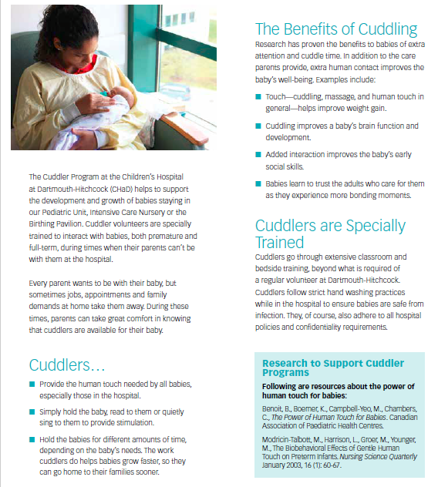
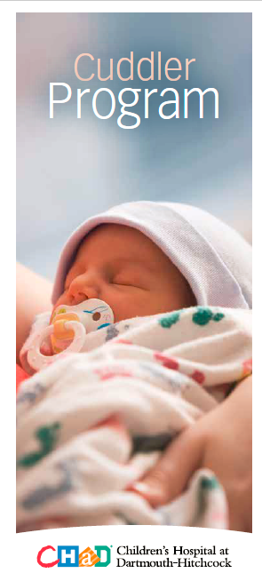

Slide 26

COMMUNITY RESOURCES
Information and Referral
  NH Resource 211 802-652-4636
  VT Resource 211 866-444-4211
Support/Home-based programs (e.g., VNA, Good Beginnings, Parenting Programs)
Health and Mental Health / Treatment Programs
Child Protective Services
Domestic/Family Violence
Housing
Emergency Financial Assistance
Legal Assistance
Transportation
Long-term follow-up programs / interventions (e.g., Early Intervention)

Slide 27
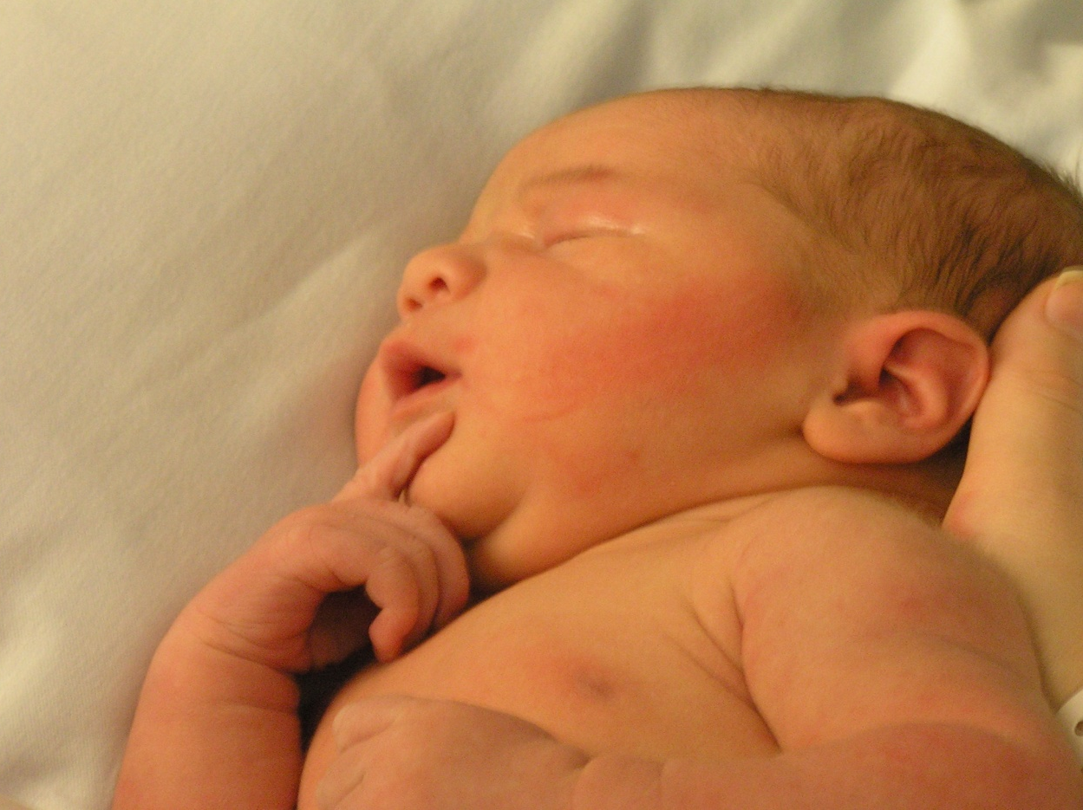
QUESTIONS?

